Slide 1

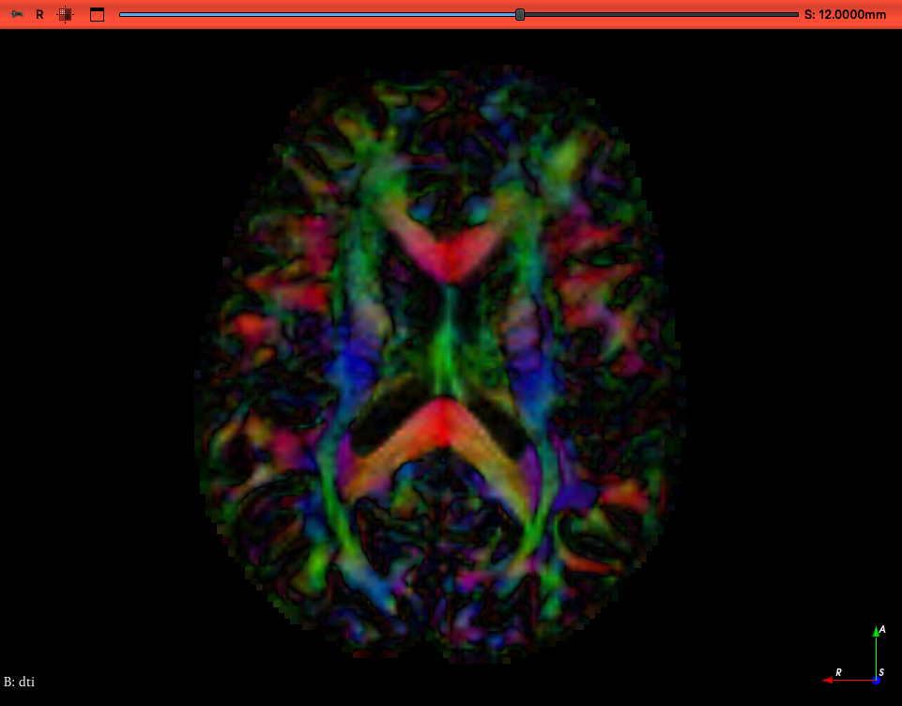
Sunnybrook Summer School: Diffusion MRI
Colleen Bailey, Liam Lawrence, Rachel Chan
August 18, 2025

Slide 2
Outline
Diffusion Basics
Diffusion Sequences I (diffusion encoding)
Qualitative: diffusion weighted imaging
Quantitative: b-values and apparent diffusion coefficient
Anisotropy: diffusion tensor imaging
Diffusion Sequences II (image encoding)
Tradeoffs
Artefacts
Processing Pipeline and Analysis Tools

Slide 3
Water Motion: A relationship between space and time
t=0
After time Δt
Brownian motion
“Random walk”
Diffusion coefficient
(temperature dependent)
Δr = √6DΔt
Displacement
time
Diffusion Basics
Sequences I: Diffusion Encoding
b-value and ADC
Sequences II: Image Encoding
Anisotropy and DTI
Sequences II: Tradeoffs
Sequences II: Artefacts
Processing Pipeline
Notes:
What the MRI is measuring here is the effect of molecular diffusion due to Brownian motion. Where molecules will randomly move around from a region of high to low concentration, bouncing around along a trajectory that is sometimes referred to as “random walk” (show trajectory). The rate at which the molecules diffuse is governed by this equation, where the distance diffused is dependent on the diffusion coefficient and the amount of time passed. I won’t say too much more because DWI will be discussed thoroughly in a different lecture.

Slide 4
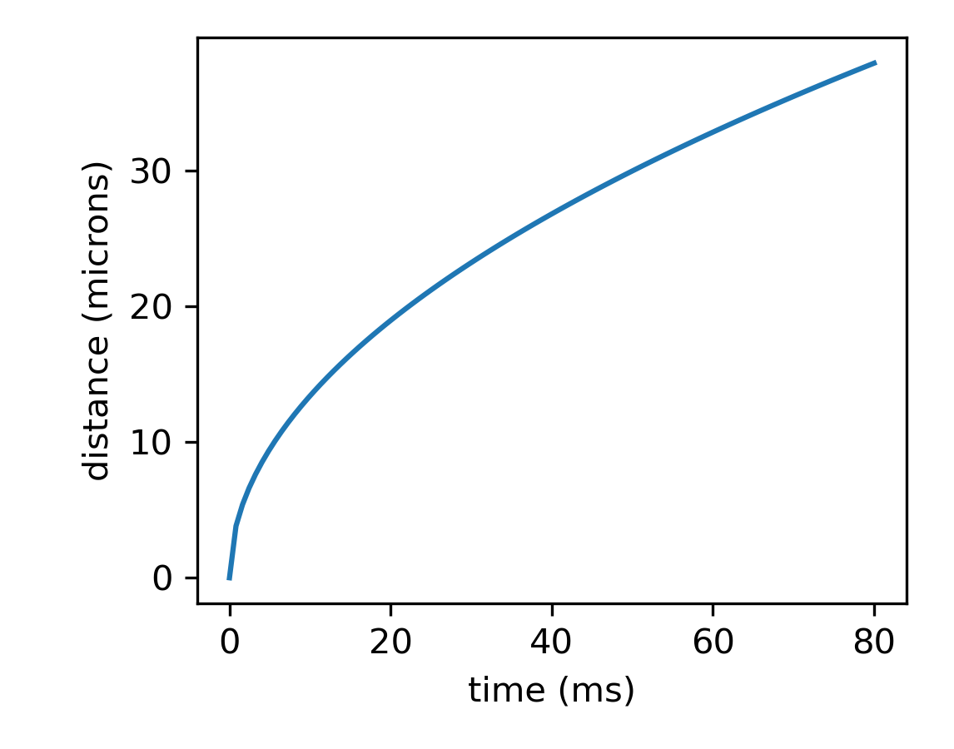
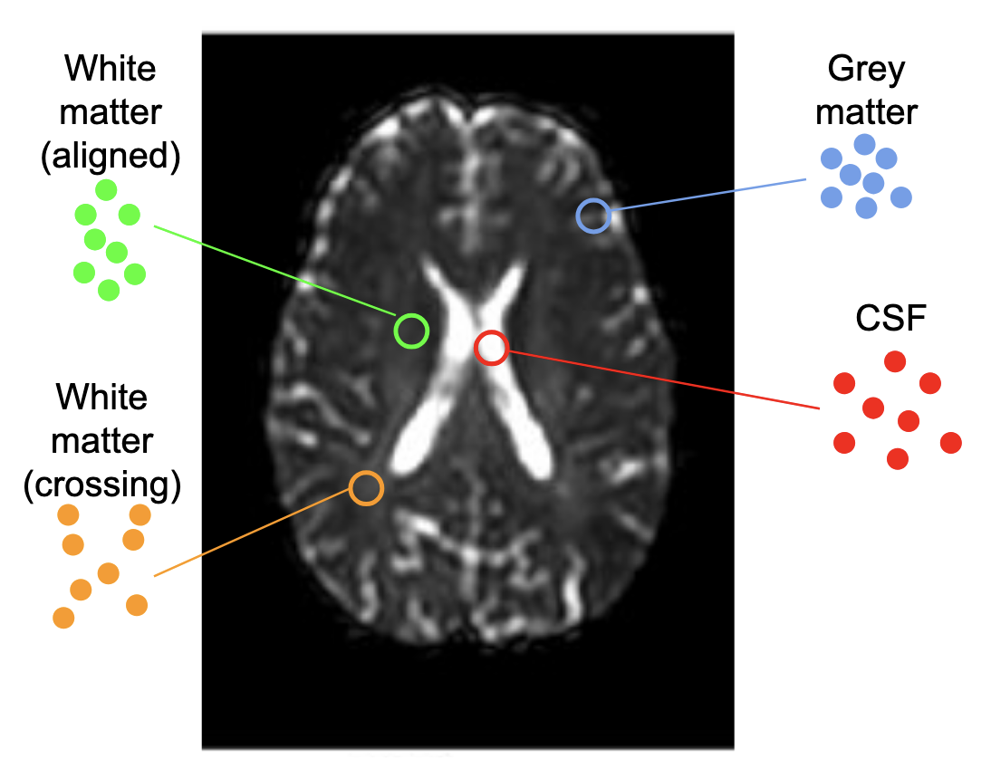
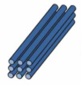
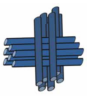
A rough idea of scale
Water at 37°C: D ~ 3 µm²/ms
Example Probability Density Functions
Diffusion Basics
Sequences I: Diffusion Encoding
b-value and ADC
Sequences II: Image Encoding
Anisotropy and DTI
Sequences II: Tradeoffs
Sequences II: Artefacts
Processing Pipeline

Slide 5
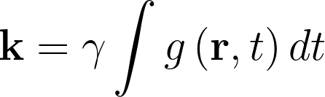
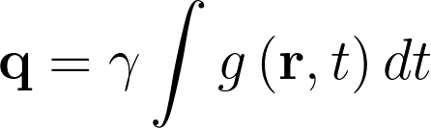
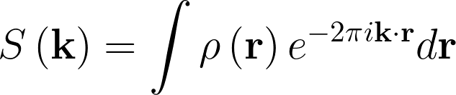
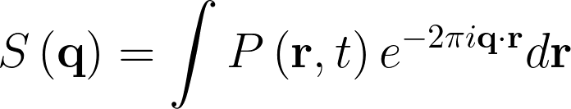
MRI encodes spatial information using gradients
The phase and readout gradients encode spatial location
Acquire data in k-space
Further out in k-space, higher spatial frequencies
The diffusion gradients encode spatial location
Acquire data in q-space
Further out in q-space, more sensitive to small displacements
But also dependence on diffusion time
For Imaging
For Diffusion
Diffusion Basics
Sequences I: Diffusion Encoding
b-value and ADC
Sequences II: Image Encoding
Anisotropy and DTI
Sequences II: Tradeoffs
Sequences II: Artefacts
Processing Pipeline

Slide 6
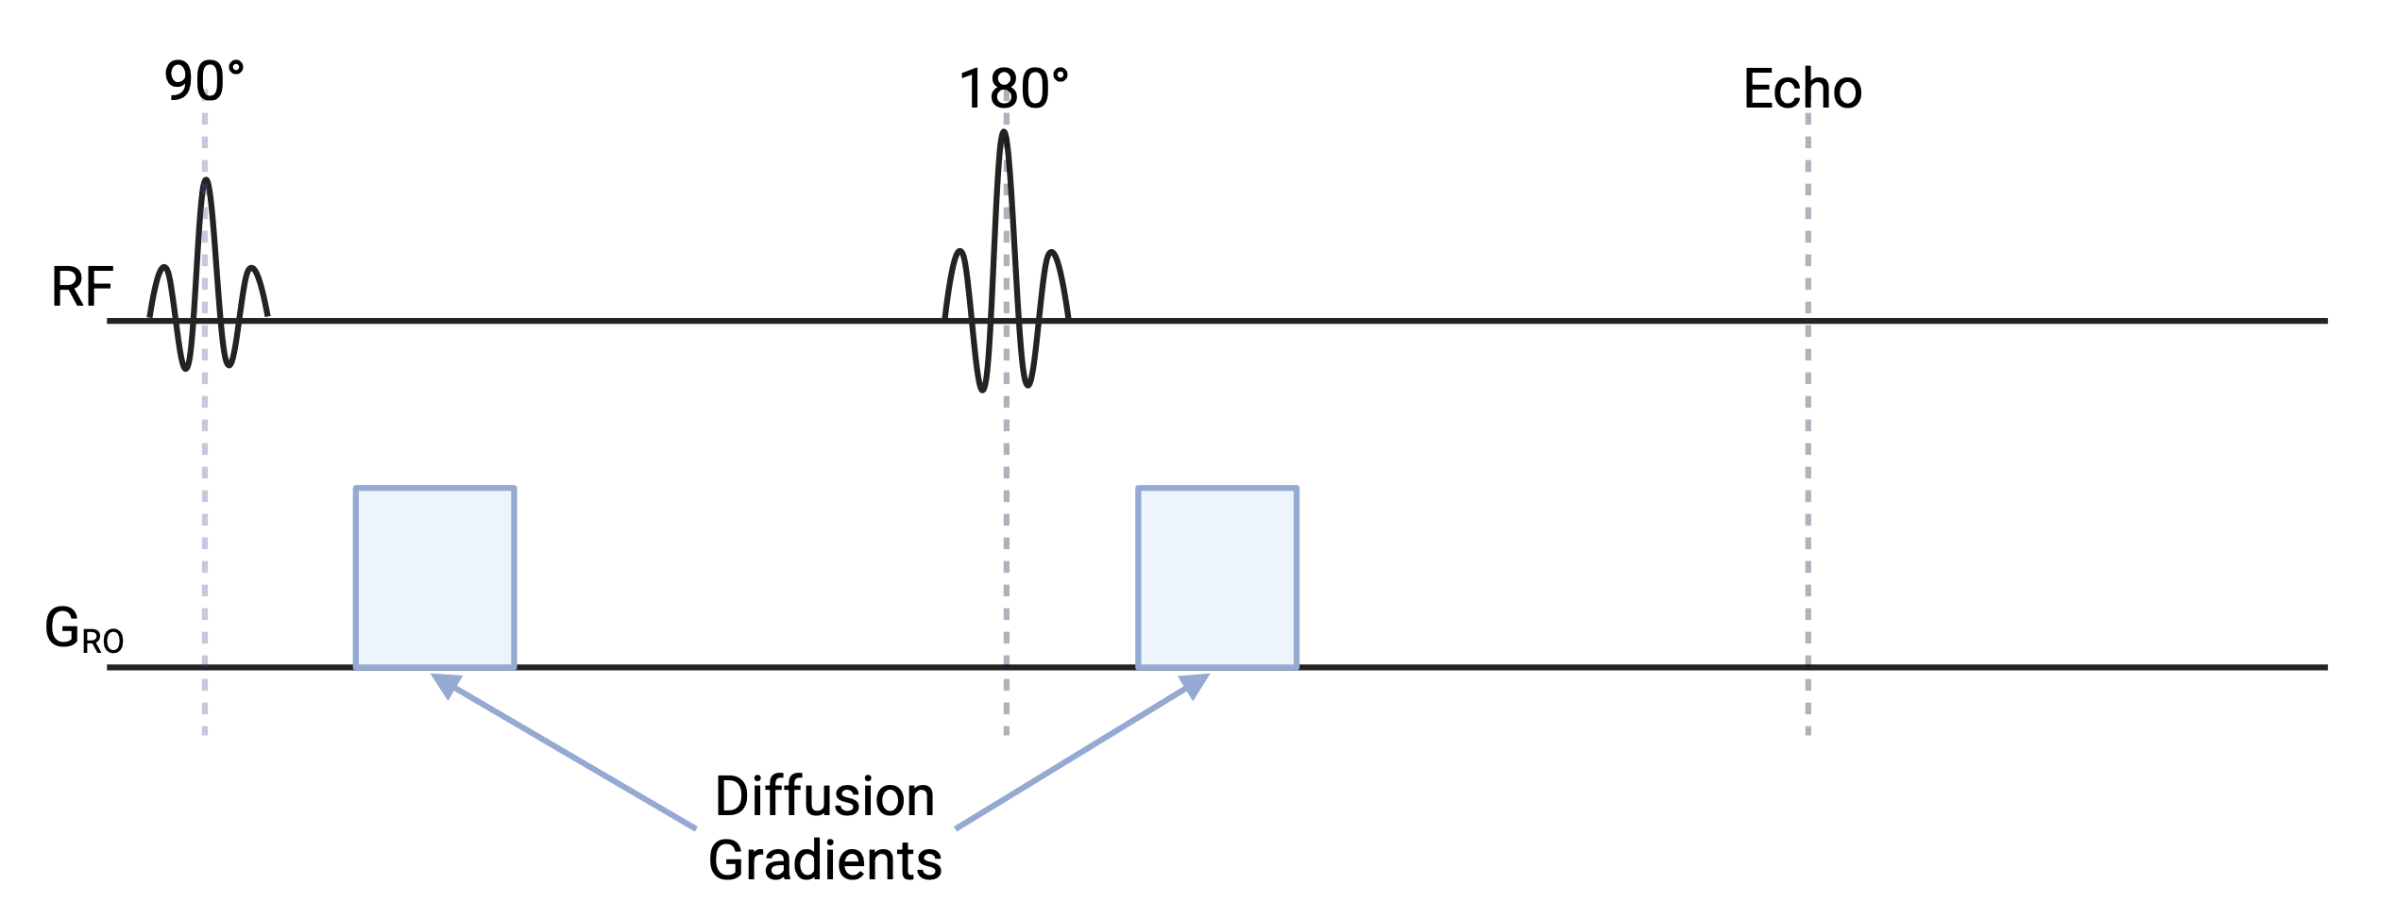
A diffusion pulse sequence walkthrough
...Image encoding (next section)
Read left-to-right as a series of scanner instructions about rf pulses and gradients
Most common diffusion sequence: Pulsed Gradient Spin Echo (PGSE) AKA Stejskal-Tanner diffusion sequence (1965)
To explain how this sequence is sensitive to water motion, consider two situations: without and with motion.
Diffusion Basics
Sequences I: Diffusion Encoding
b-value and ADC
Sequences II: Image Encoding
Anisotropy and DTI
Sequences II: Tradeoffs
Sequences II: Artefacts
Processing Pipeline

Slide 7
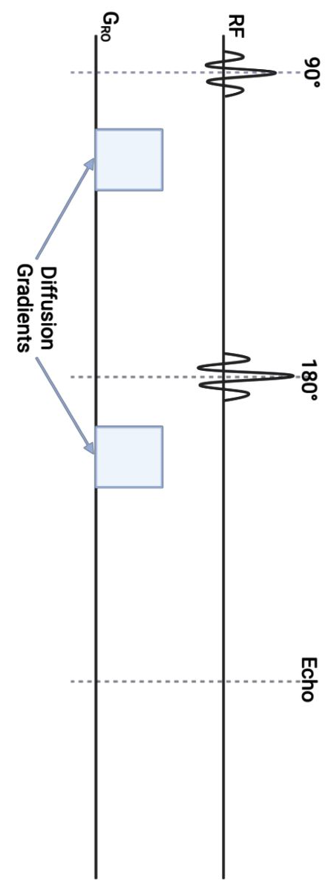
A diffusion pulse sequence walkthrough
Diffusion Basics
Sequences I: Diffusion Encoding
b-value and ADC
Sequences II: Image Encoding
Anisotropy and DTI
Sequences II: Tradeoffs
Sequences II: Artefacts
Processing Pipeline

Slide 8
A diffusion pulse sequence walkthrough
90°
Effective diffusion gradient
Diffusion Basics
Sequences I: Diffusion Encoding
b-value and ADC
Sequences II: Image Encoding
Anisotropy and DTI
Sequences II: Tradeoffs
Sequences II: Artefacts
Processing Pipeline

Slide 9
Consider two spins in different positions after a 90⁰ pulse
Excitation
90°
position
Diffusion Basics
Sequences I: Diffusion Encoding
b-value and ADC
Sequences II: Image Encoding
Anisotropy and DTI
Sequences II: Tradeoffs
Sequences II: Artefacts
Processing Pipeline

Slide 10
Turning on a magnetic field gradient means spins in different positions precess at different frequencies. When the gradient turns off, the spins are dephased.
Excitation
90°
dB_{z}
Fast
Slow
Gradient on
Dephasing
Gradient off
position
Diffusion Basics
Sequences I: Diffusion Encoding
b-value and ADC
Sequences II: Image Encoding
Anisotropy and DTI
Sequences II: Tradeoffs
Sequences II: Artefacts
Processing Pipeline

Slide 11
Then wait. During this diffusion time, the spins may move. First consider the case with no motion.
Excitation
90°
Gradient on
Gradient off
Wait
dB_{z}
position
Diffusion Basics
Sequences I: Diffusion Encoding
b-value and ADC
Sequences II: Image Encoding
Anisotropy and DTI
Sequences II: Tradeoffs
Sequences II: Artefacts
Processing Pipeline

Slide 12
When gradients are applied in the opposite direction, the left spin now precesses faster than the right. If this gradient is on for the same time, the spins rephase.
Excitation
90°
Gradient on
Gradient off
Wait
Opposing gradient on
dB_{z}
Slow
Fast
Rephasing
Gradient off
position
Diffusion Basics
Sequences I: Diffusion Encoding
b-value and ADC
Sequences II: Image Encoding
Anisotropy and DTI
Sequences II: Tradeoffs
Sequences II: Artefacts
Processing Pipeline

Slide 13
If we read out (sum) the signal from all spins in the voxel, they will all be aligned and signal will be high
Excitation
90°
Gradient on
Gradient off
Wait
Opposing gradient on
dB_{z}
Slow
Fast
Rephasing
Gradient off
position
Acquire signal

Slide 14
Now consider spins that move during the diffusion time
Excitation
90°
dB_{z}
Gradient on
Dephasing
Gradient off
position
Wait
Diffusion Basics
Sequences I: Diffusion Encoding
b-value and ADC
Sequences II: Image Encoding
Anisotropy and DTI
Sequences II: Tradeoffs
Sequences II: Artefacts
Processing Pipeline

Slide 15
A dephased spin moves…
Excitation
90°
Gradient on
Gradient off
Wait
dB_{z}
position
Diffusion Basics
Sequences I: Diffusion Encoding
b-value and ADC
Sequences II: Image Encoding
Anisotropy and DTI
Sequences II: Tradeoffs
Sequences II: Artefacts
Processing Pipeline

Slide 16
The gradient at the new position is not as large. The spins do not completely rephase.
Excitation
90°
Gradient on
Gradient off
Wait
Opposing gradient on
dB_{z}
Partial
rephasing
Gradient off
position
Diffusion Basics
Sequences I: Diffusion Encoding
b-value and ADC
Sequences II: Image Encoding
Anisotropy and DTI
Sequences II: Tradeoffs
Sequences II: Artefacts
Processing Pipeline

Slide 17
Summing all spins at all positions in the voxel, they are no longer in phase and we get a much smaller signal (the signal attenuates more when spins have moved more)
Excitation
90°
Gradient on
Gradient off
Wait
Opposing gradient on
dB_{z}
Partial
rephasing
Gradient off
position
Acquire signal

Slide 18
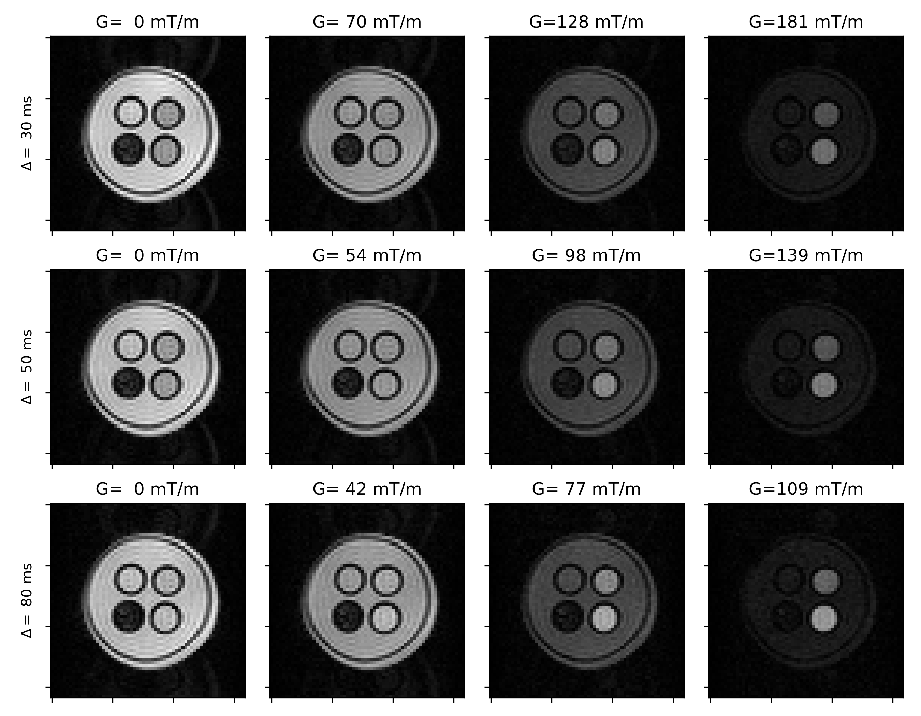
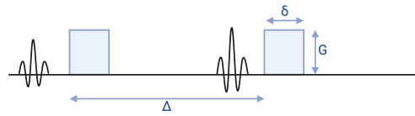
When water moves, DWI signal gets lower
water
cells
How much lower depends on
Scan parameters: gradient amplitude (G), gradient duration (δ), gradient separation (Δ)
Tissue properties
Can we go beyond DWI and quantify diffusion?
Where are these parameters on the scanner?
Which should you set and to what values?
Diffusion Basics
Sequences I: Diffusion Encoding
b-value and ADC
Sequences II: Image Encoding
Anisotropy and DTI
Sequences II: Tradeoffs
Sequences II: Artefacts
Processing Pipeline

Slide 19
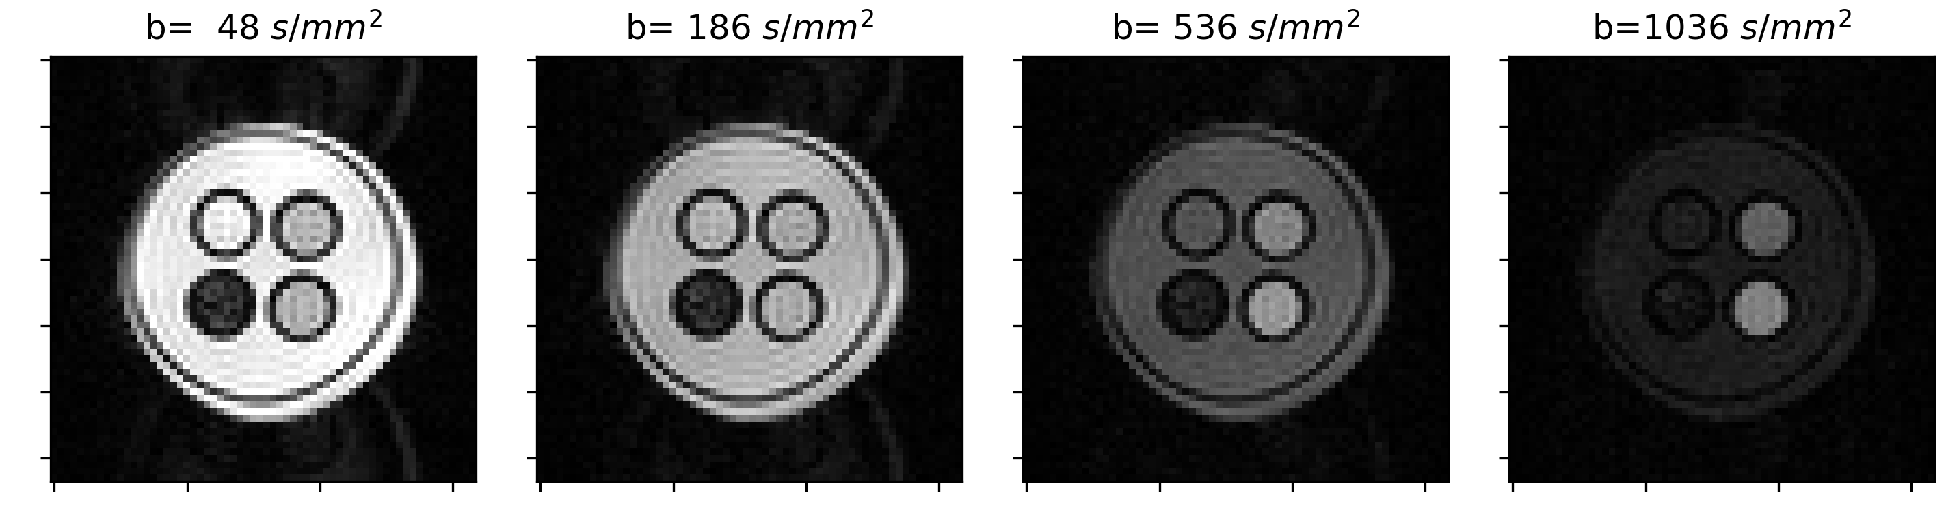
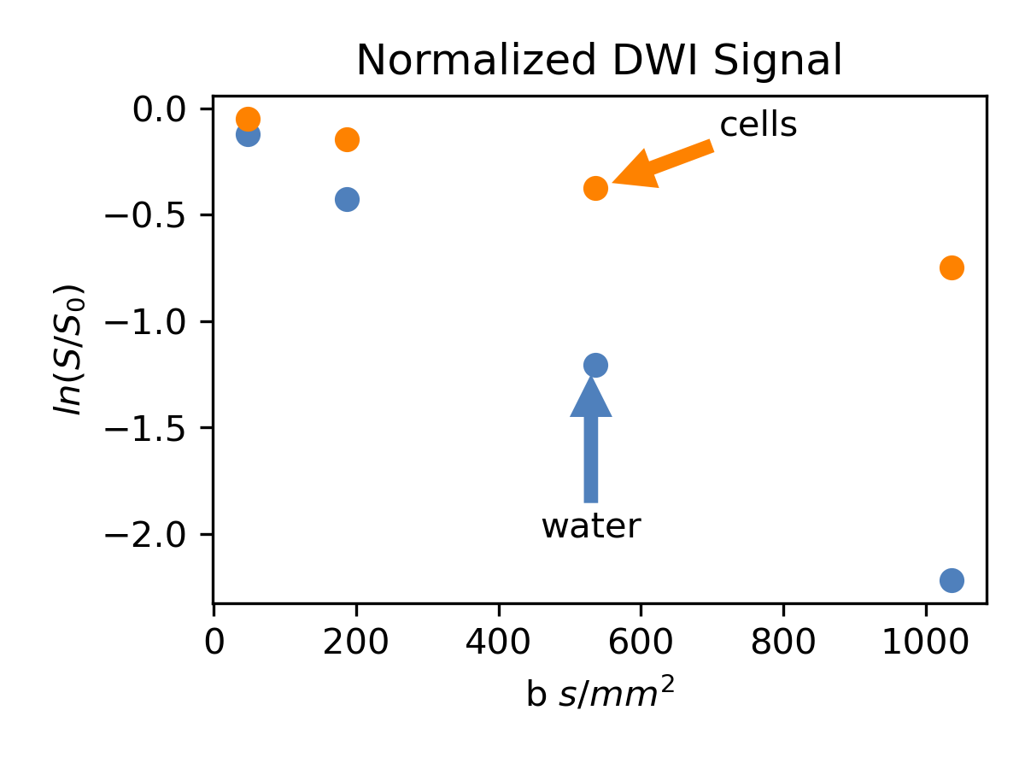
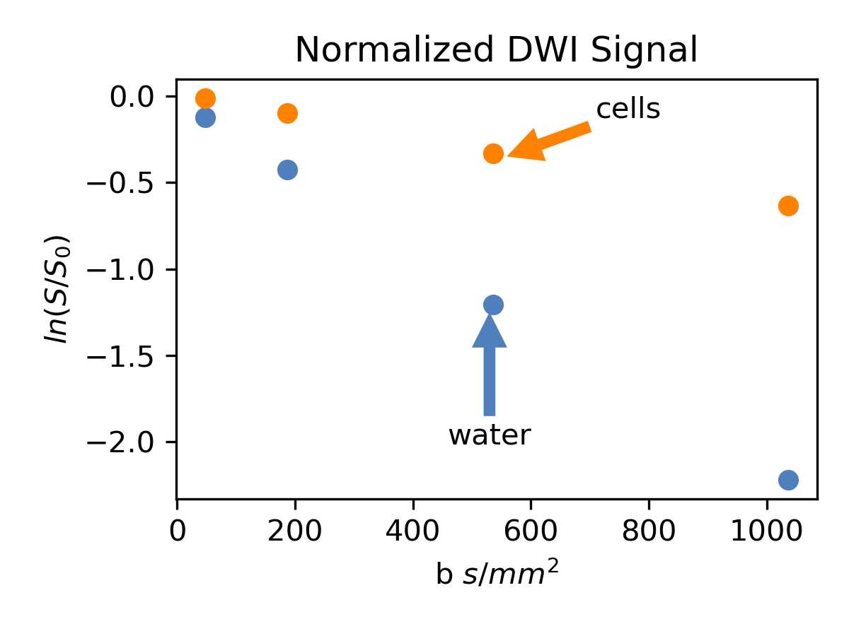
Quantification: b-value and Apparent Diffusion Coefficient (ADC)
water
cells
The b-value summarizes the scan parameters into one number: b=(γGδ)²(Δ-δ/3)
For Gaussian diffusion: ln(S/S₀)=-b*ADC
Diffusion Basics
Sequences I: Diffusion Encoding
b-value and ADC
Sequences II: Image Encoding
Anisotropy and DTI
Sequences II: Tradeoffs
Sequences II: Artefacts
Processing Pipeline

Slide 20
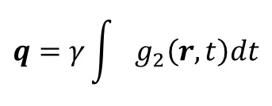
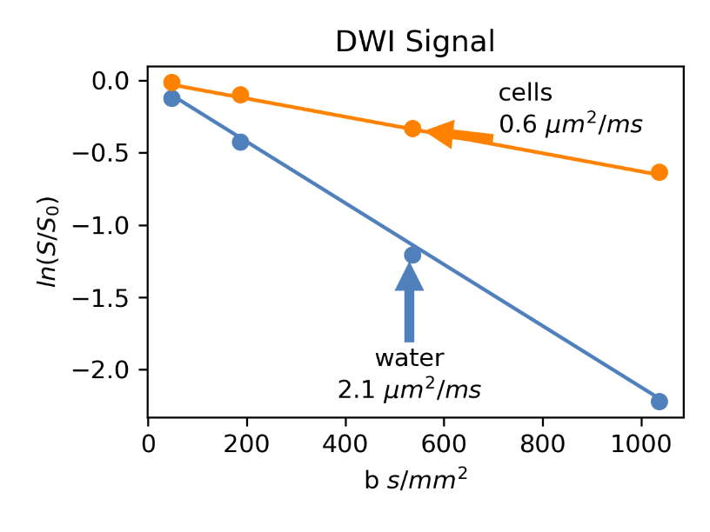
Quantification: b-value and Apparent Diffusion Coefficient (ADC)
water
cells
The b-value summarizes the scan parameters into one number: b=(γGδ)²(Δ-δ/3)
For Gaussian diffusion: ln(S/S₀)=-b*ADC
Can calculate ADC from 2 b-values
Diffusion Basics
Sequences I: Diffusion Encoding
b-value and ADC
Sequences II: Image Encoding
Anisotropy and DTI
Sequences II: Tradeoffs
Sequences II: Artefacts
Processing Pipeline
Notes:
So you really only need two points to define a line

Slide 21
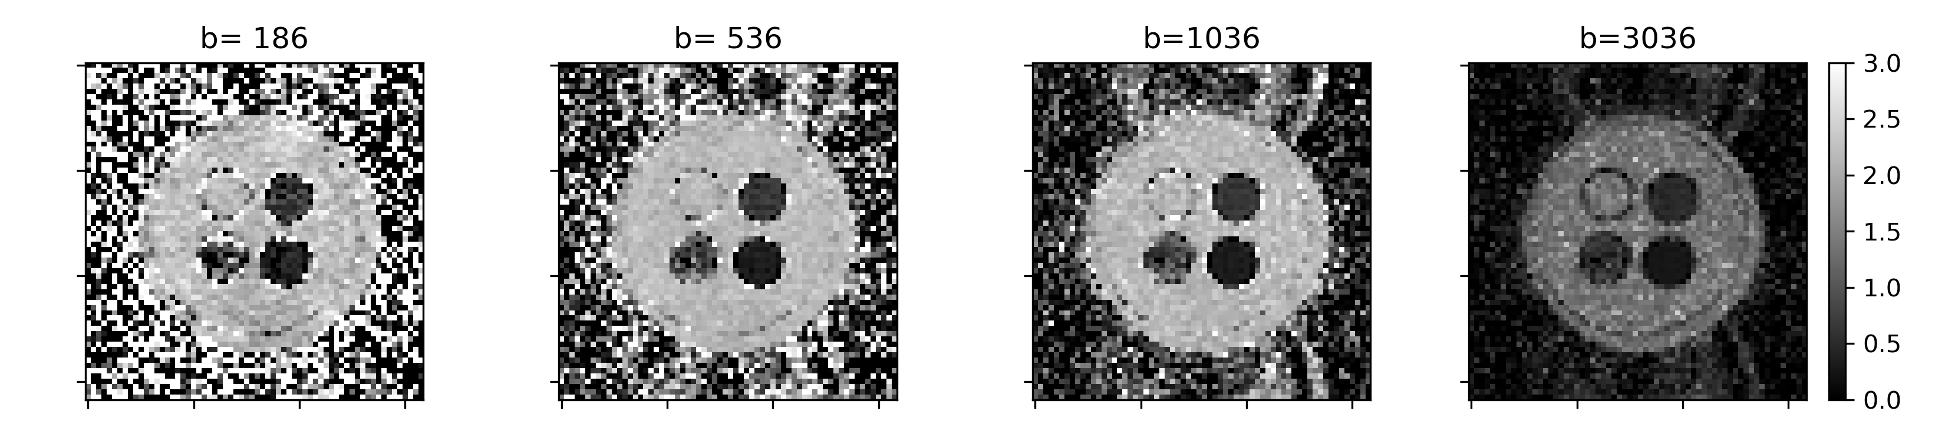
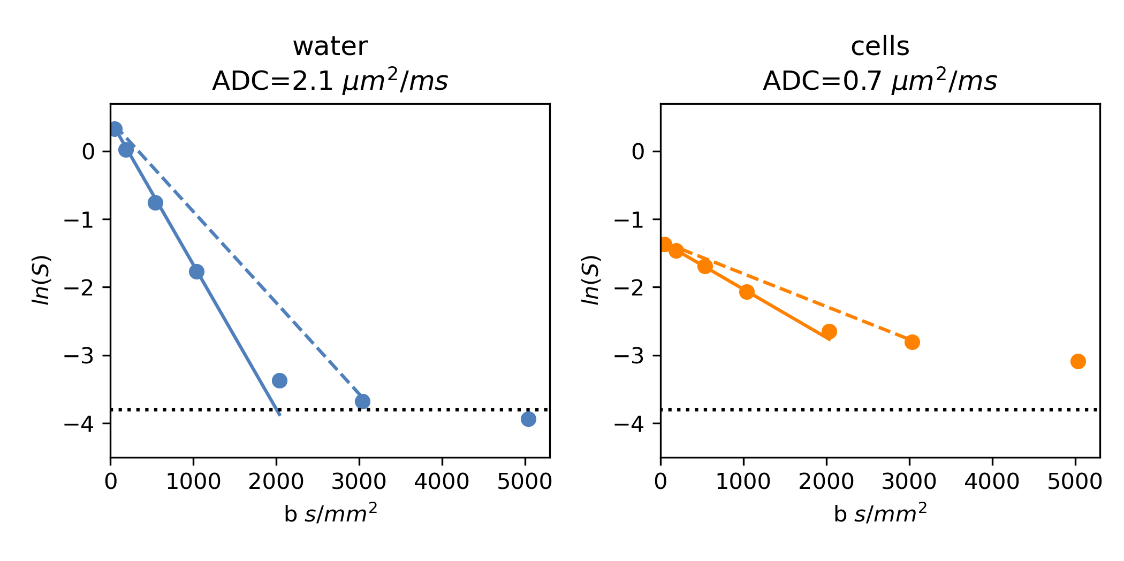
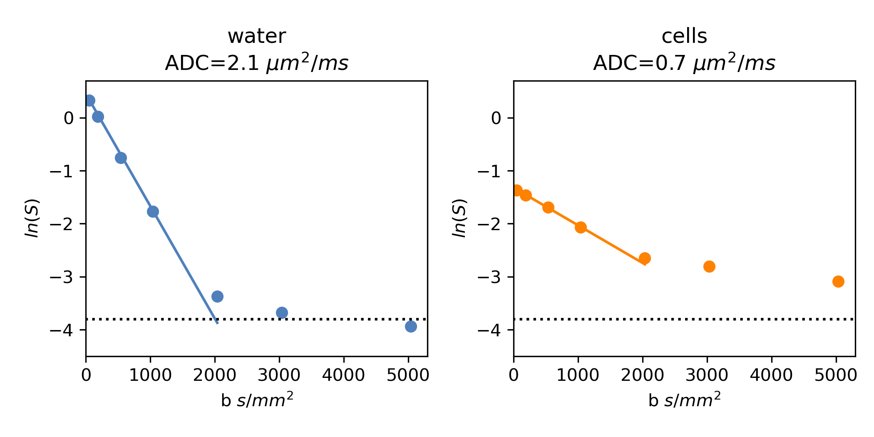
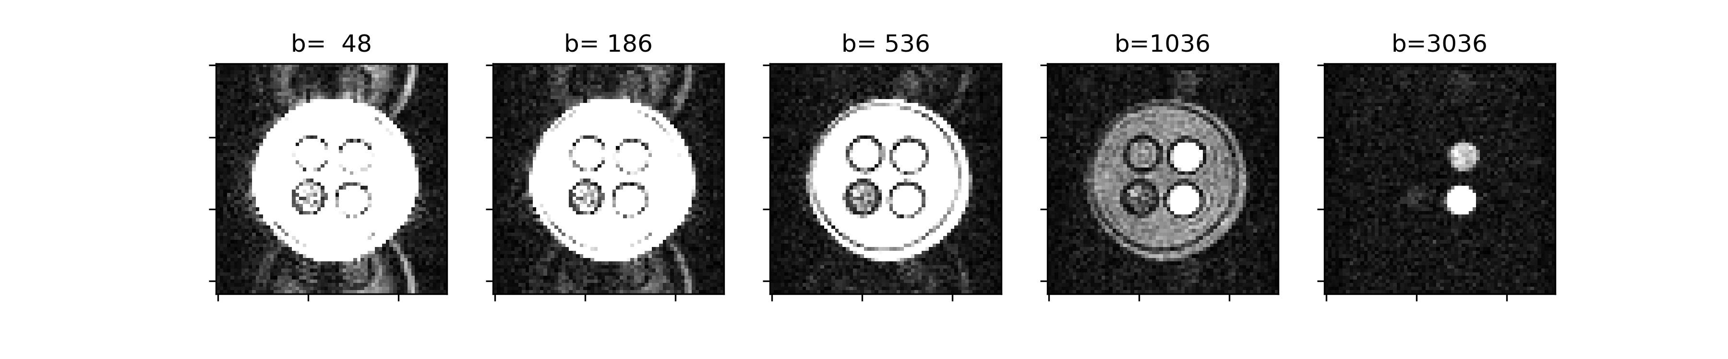
Why don't these ADCs for water agree?
ADC
water
1.3 µm²/ms
2.1 µm²/ms
DWI
It's noise!
Always check the DWI *and* the ADC map
SNR limits are one reason diffusion has larger voxels than structural
Diffusion Basics
Sequences I: Diffusion Encoding
b-value and ADC
Sequences II: Image Encoding
Anisotropy and DTI
Sequences II: Tradeoffs
Sequences II: Artefacts
Processing Pipeline
Notes:
Many scanners automatically generate an ADC map
Could consider a question on SNR. If you go from 1x1x1 mm3 voxel to 2x2x2 mm3, you get 8x the SNR. You would have to scan 64x longer to get the same boost in SNR just from averages. (Lower resolution also allows you to do fewer phase encodes and reduces TE, so maybe this should go later).

Slide 22
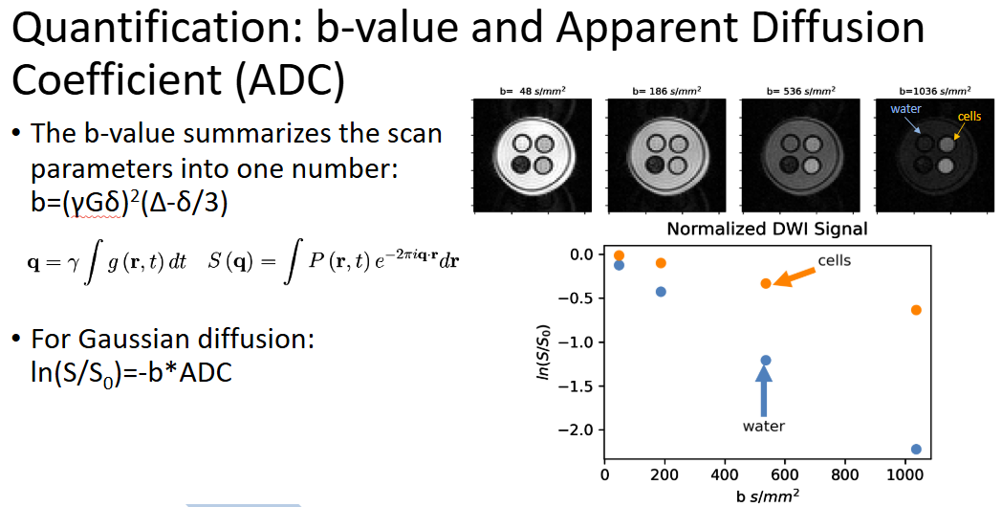
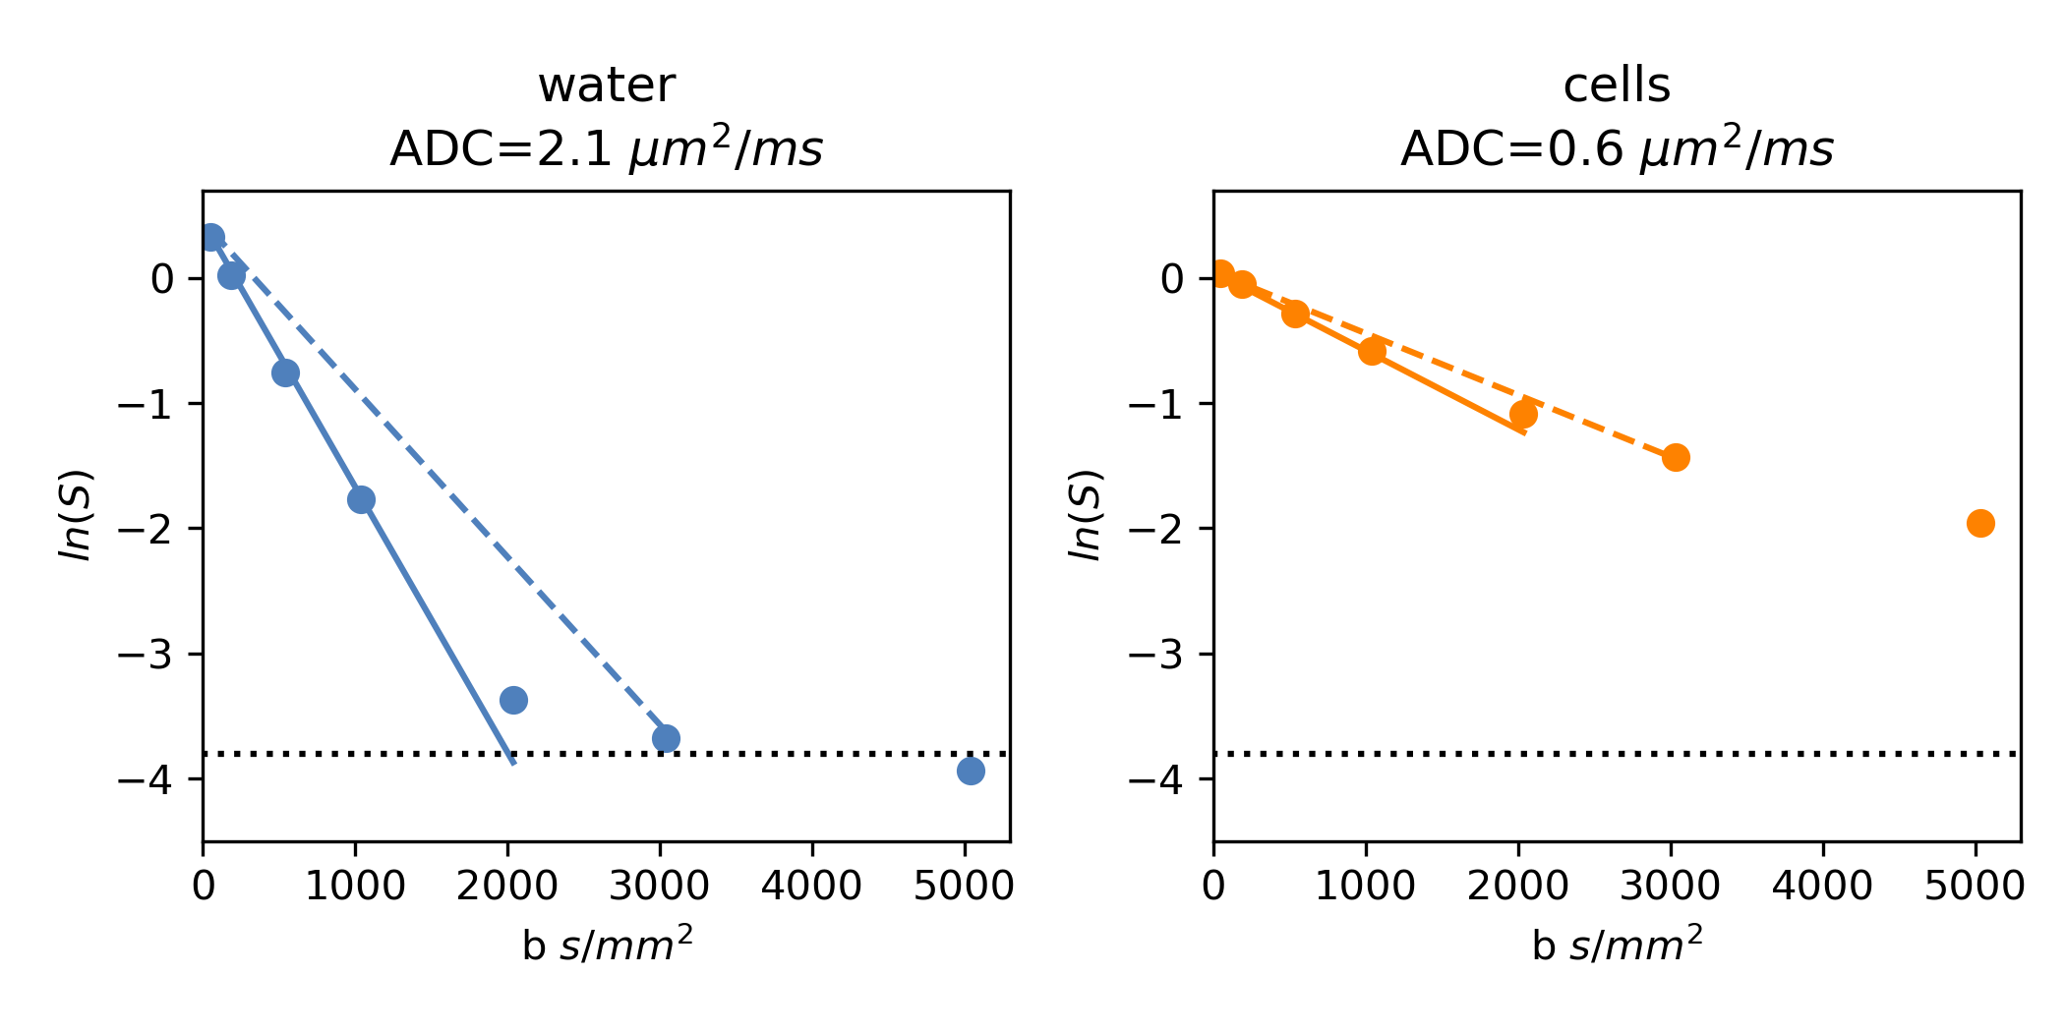
Why don't these ADCs for cells agree?
ADC
cells
0.6 µm²/ms
0.5 µm²/ms
DWI
Diffusion Basics
Sequences I: Diffusion Encoding
b-value and ADC
Sequences II: Image Encoding
Anisotropy and DTI
Sequences II: Tradeoffs
Sequences II: Artefacts
Processing Pipeline

Slide 23
Why don't these ADCs for cells agree?
ADC
cells
0.6 µm²/ms
0.5 µm²/ms
DWI
Water in cells does not undergo Gaussian diffusion at high b!
Even if you see signal in DWI, ADC may not be appropriate at high b (>1000 s/mm²)
Diffusion Basics
Sequences I: Diffusion Encoding
b-value and ADC
Sequences II: Image Encoding
Anisotropy and DTI
Sequences II: Tradeoffs
Sequences II: Artefacts
Processing Pipeline

Slide 24
There are hardware and practical limitations
The scanner has a maximum gradient amplitude
TE limits gradient duration and separation
Longer TEs have lower SNR (T2 decay)
A "b-value" may not mean the same thing on different scanners.
Scanner (3 T) | Max Gradient (mT/m)
GE Signa Architect | 44
GE Signa Premier | 80
Philips Ingenia Elition | 45
Philips MR 7700 | 65
Siemens Skyra | 45
Siemens Prisma | 80
Siemens Connectom | 300
Diffusion Basics
Sequences I: Diffusion Encoding
b-value and ADC
Sequences II: Image Encoding
Anisotropy and DTI
Sequences II: Tradeoffs
Sequences II: Artefacts
Processing Pipeline
Notes:
I wanted to do a little vendor comparison of their max DC gradients and thus the b-value that you would get at a particular diffusion time for their PGSE sequence (although it's complicated if Siemens doesn't even use PGSE by default).
Multi-centre studies are challenging, even with good QA.
Images of scanner GUIs? Not all allow control of all parameters or even let you easily see them

Slide 25
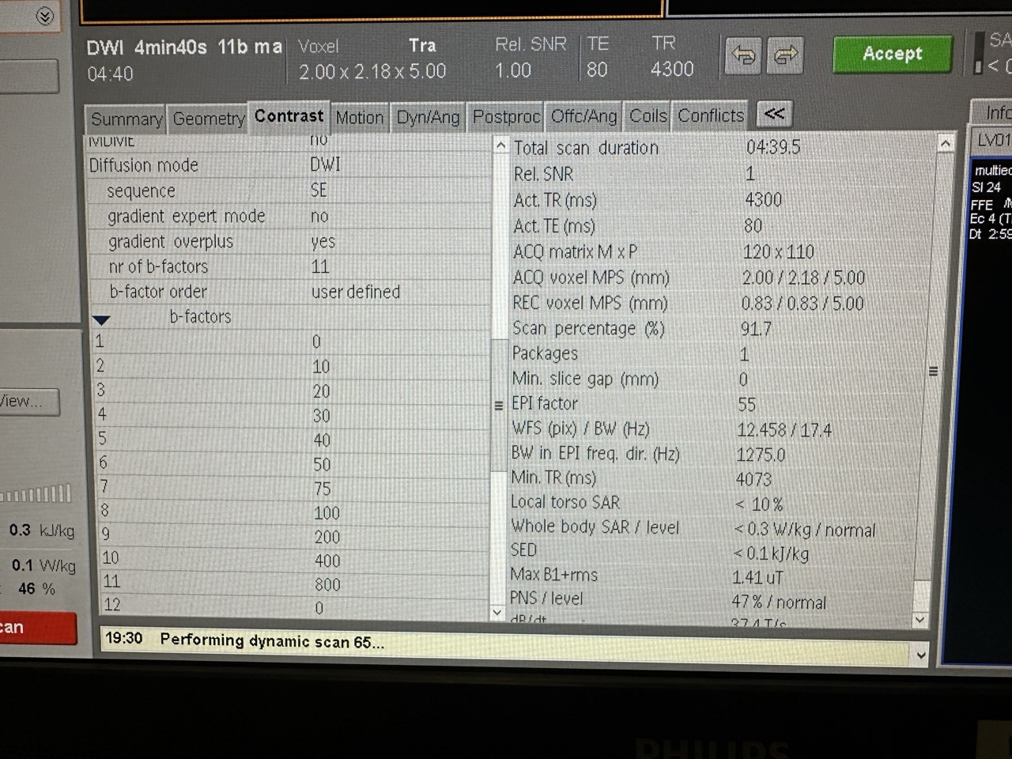
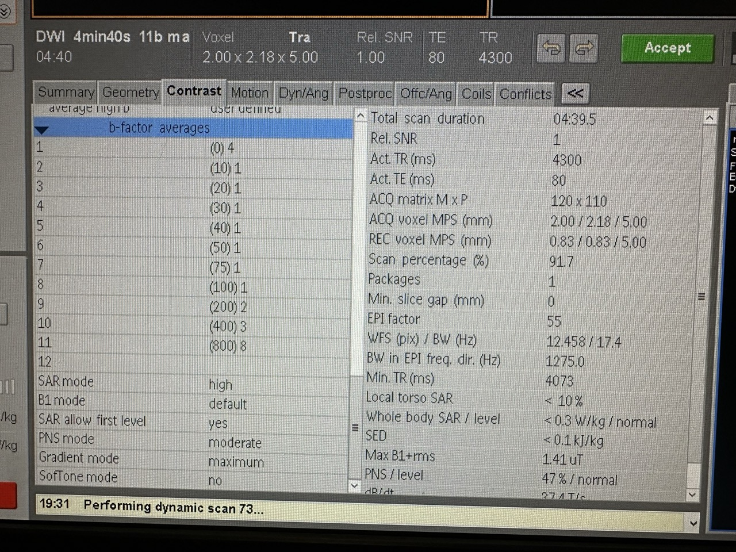
Example Scanner Interface

Slide 26
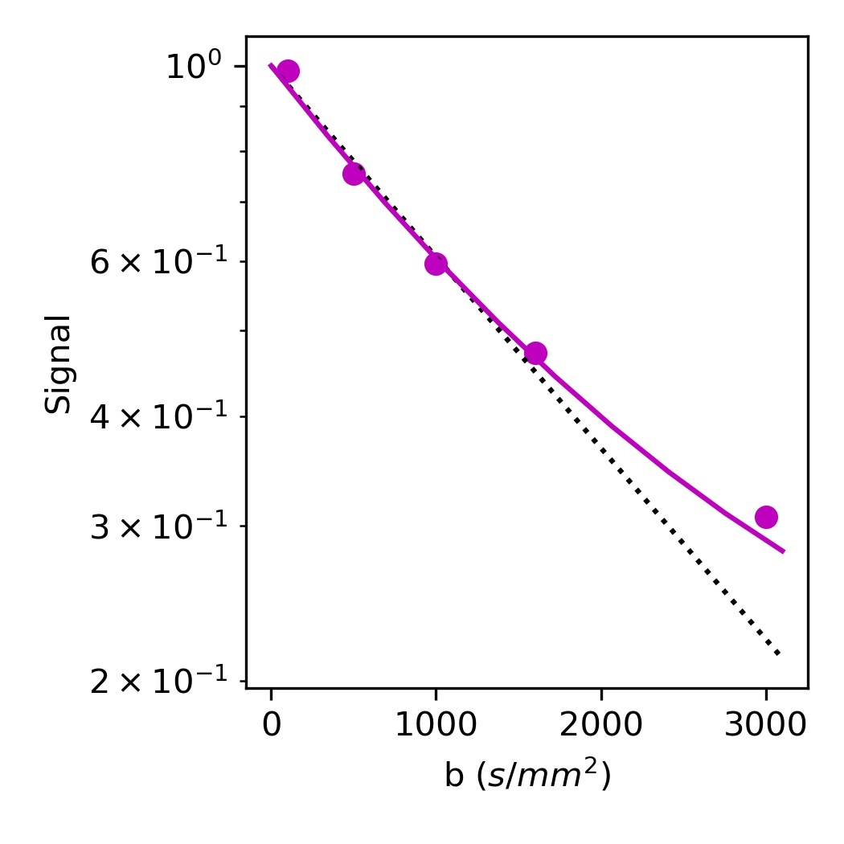
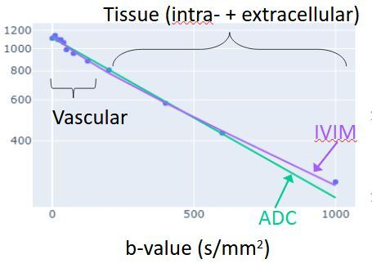
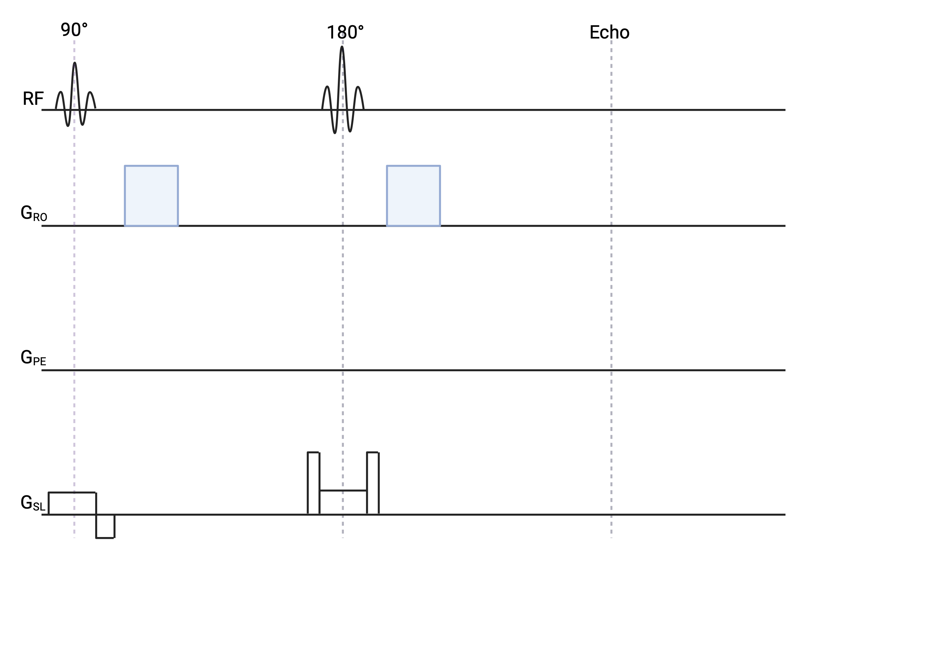
Other Considerations for DWI and ADC
ADC is commonly used for quantification at low b (exact value is scanner-dependent)
Kurtosis or axon diameter mapping can be used for quantification at high b
Low b-values may be affected by blood flow in capillaries (modelled by IVIM)
Slice selection gradients can contribute to diffusion weighting (mainly at low b).
Diffusion Basics
Sequences I: Diffusion Encoding
b-value and ADC
Sequences II: Image Encoding
Anisotropy and DTI
Sequences II: Tradeoffs
Sequences II: Artefacts
Processing Pipeline
Notes:
(Move the slice select info to artefacts/tips section?)

Slide 27
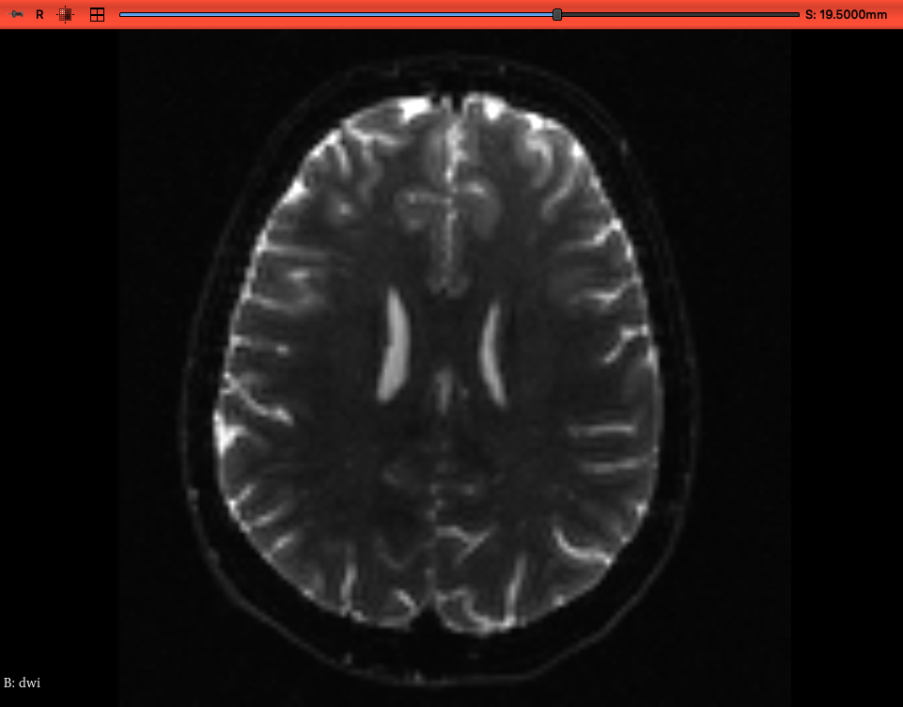
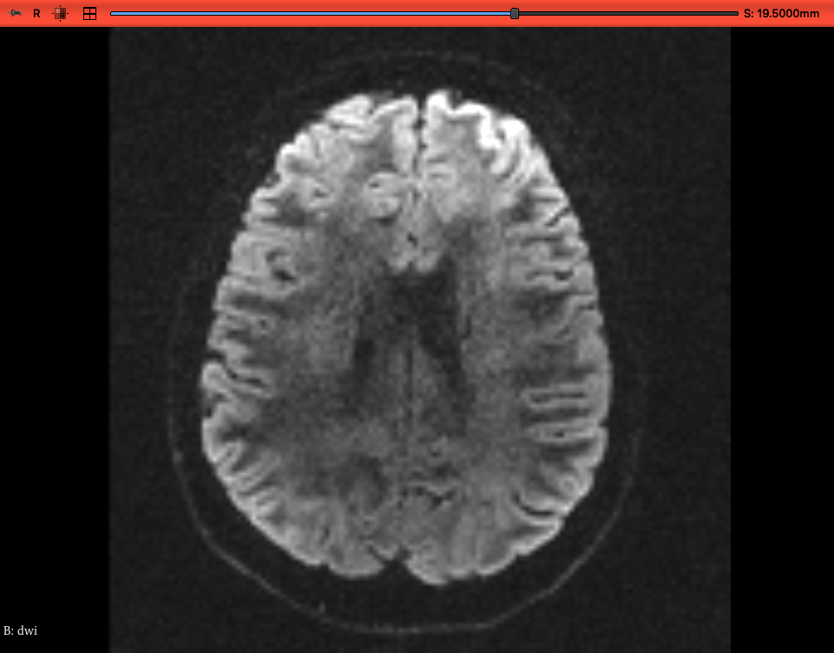
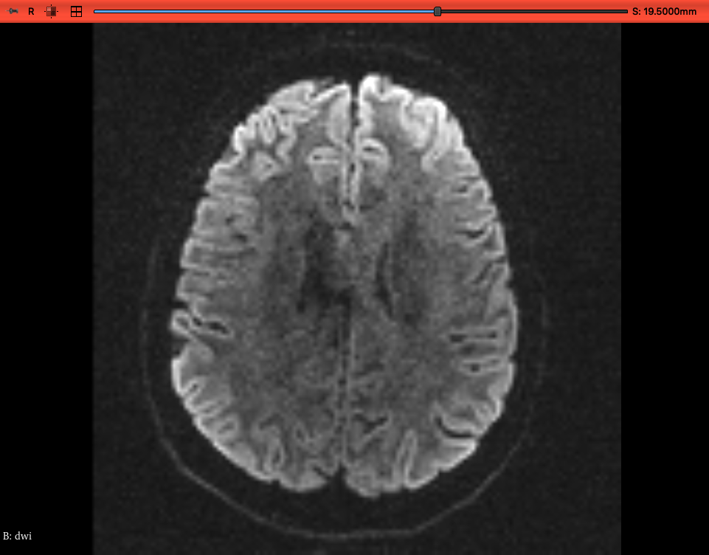
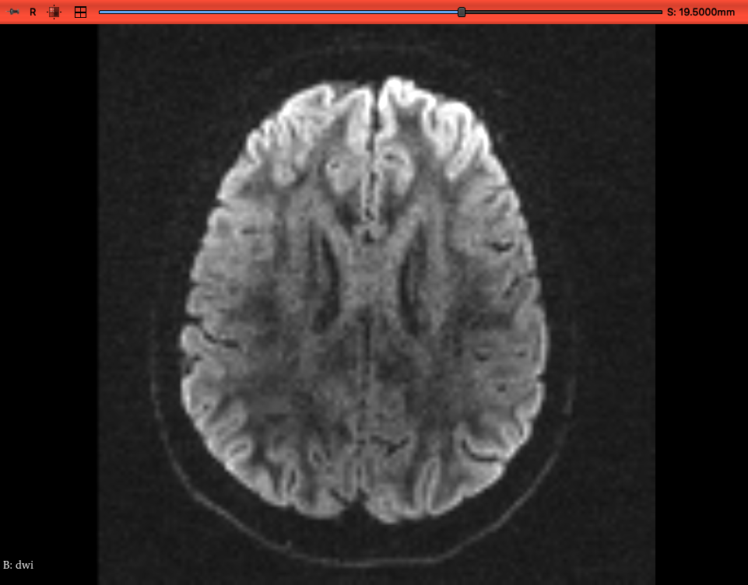
Anisotropy and Diffusion Tensor Imaging (DTI)
Unweighted Image
Direction 1
Scanners typically have 3 gradient coils
Turn on in various combinations to examine water motion in different directions
Diffusion signal varies with gradient direction (eg. WM fibre orientation)
Direction 2
Direction 3
Data: https://dmri.slicer.org/docs/
Diffusion Basics
Sequences I: Diffusion Encoding
b-value and ADC
Sequences II: Image Encoding
Anisotropy and DTI
Sequences II: Tradeoffs
Sequences II: Artefacts
Processing Pipeline

Slide 28
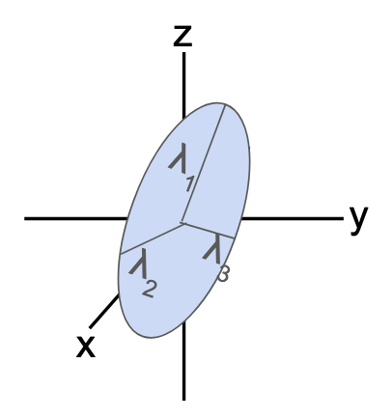
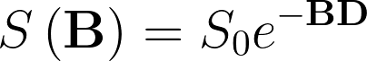
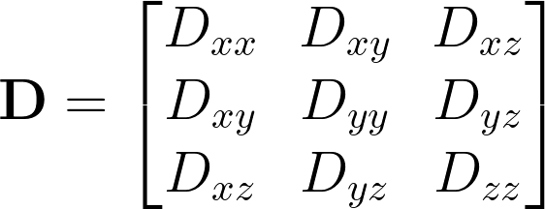
What is a tensor and what can it tell us?
Example Probability Density Functions
Can be described by a tensor
Requires 6 independent directions (plus unweighted image)
This basic tensor shape doesn't describe all possibilities but works well for aligned axons vs grey matter
?
Diffusion Basics
Sequences I: Diffusion Encoding
b-value and ADC
Sequences II: Image Encoding
Anisotropy and DTI
Sequences II: Tradeoffs
Sequences II: Artefacts
Processing Pipeline
Notes:
Simple model is the diffusion tensor; a 3x3 matrix that can be conceptualized as an ellipsoid of sorts. You might think that an ellipsoid has three measurements to define it in size, but then you also need three parameters to describe its orientation in space, so overall 6 parameters and you need at least 6 directions, to determine the diffusion tensor, plus an unweighted to determine magnitude.
Now we have a b-matrix rather than a b-value. And a diffusion tensor rather than an ADC. It is 3x3 and symmetric, hence 6 values are needed to populate it.

Slide 29
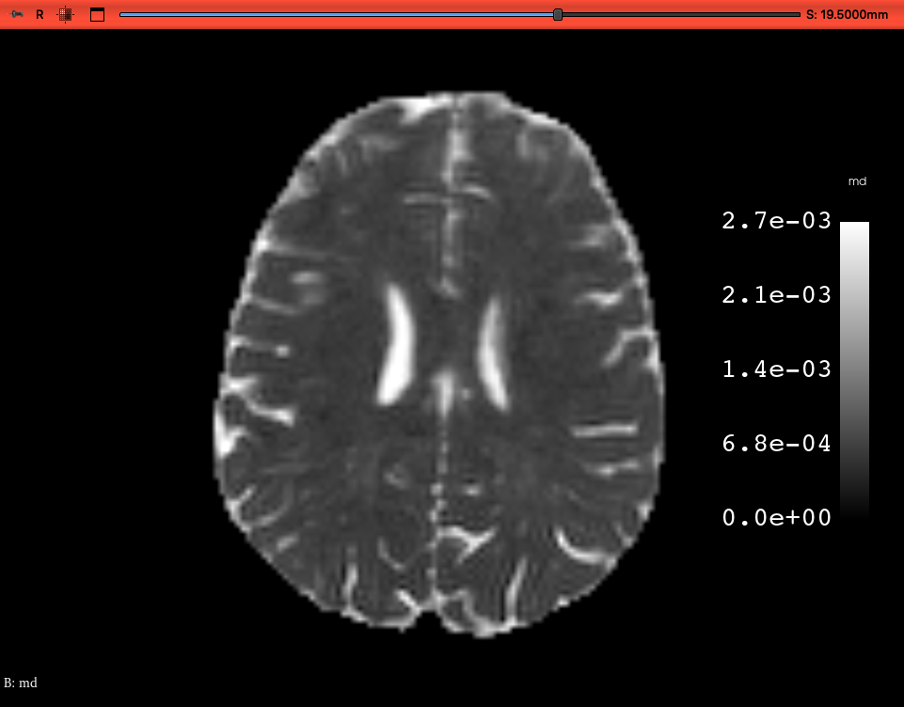
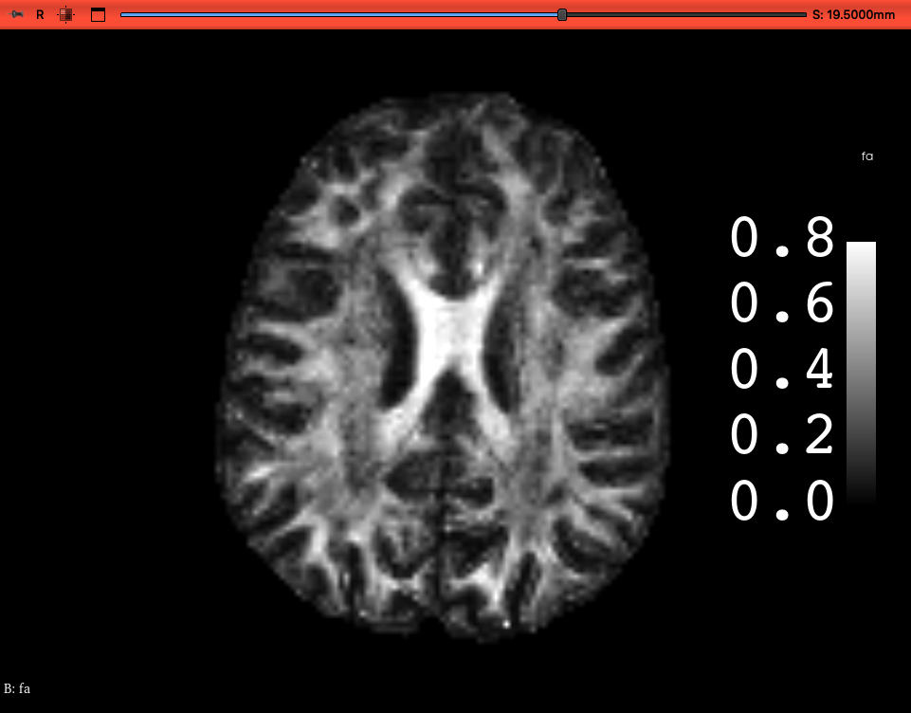
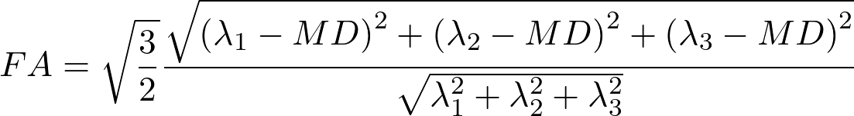
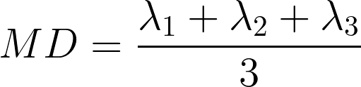
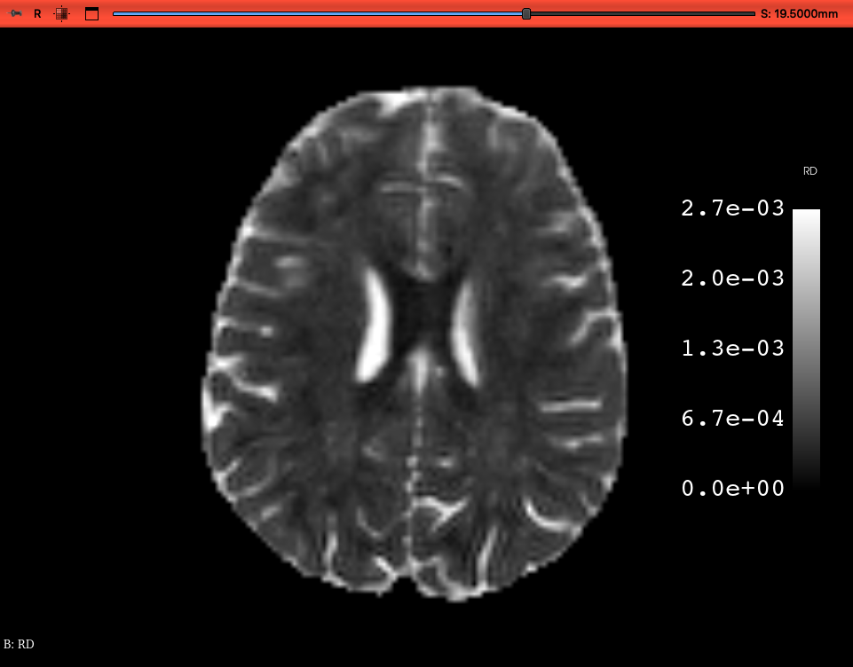
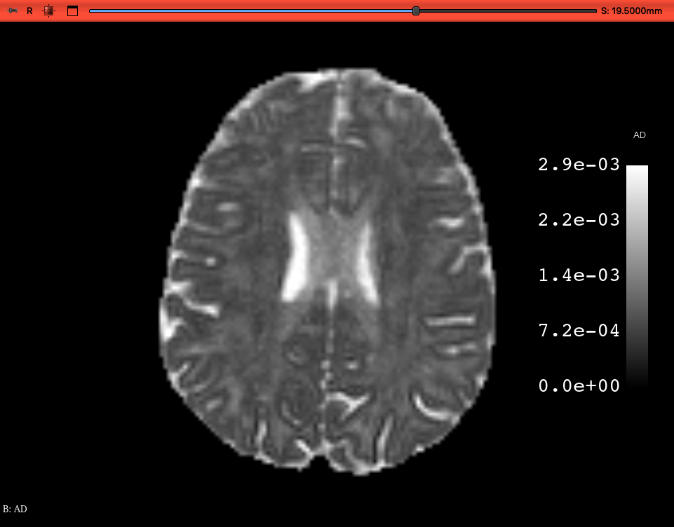
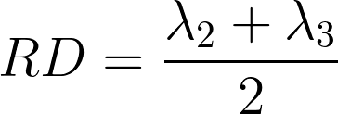
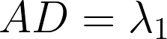
DTI – Common Summary Parameters
Mean diffusivity
Fractional Anisotoropy
Aligned fibres
Crossing fibres
Radial diffusivity
Axial diffusivity
Data: https://dmri.slicer.org/docs/
Diffusion Basics
Sequences I: Diffusion Encoding
b-value and ADC
Sequences II: Image Encoding
Anisotropy and DTI
Sequences II: Tradeoffs
Sequences II: Artefacts
Processing Pipeline
Notes:
FA equation summarizes the amount of anisotropy: 0 is isotropic and 1 would be perfectly aligned. A value of 0.7 is common in aligned WM voxels. This definition of anisotropy is independent of fibre orientation but can compound uncertainties and measurement errors. AD and RD may be less "noisy." Note that none of these tell you the actual direction of the fibres.

Slide 30
Colour FA: Summarizes FA and Fibre Direction
MD and FA are rotationally invariant scalar values, which make for easier comparisons between subjects.
Data: https://dmri.slicer.org/docs/
Diffusion Basics
Sequences I: Diffusion Encoding
b-value and ADC
Sequences II: Image Encoding
Anisotropy and DTI
Sequences II: Tradeoffs
Sequences II: Artefacts
Processing Pipeline

Slide 31
Limitations of DTI
FA is particularly sensitive to noise
Cannot account for multiple fibre orientations within a voxel
Possible to explore shapes beyond tensor
Requires more measurements and/or assumptions about the distribution
DTI assumes Gaussian diffusion
Usually done at one b-value.
Sets of directions at multiple b-values (shells) are possible but time-consuming
Quantification options include DKI and NODDI.
Diffusion Basics
Sequences I: Diffusion Encoding
b-value and ADC
Sequences II: Image Encoding
Anisotropy and DTI
Sequences II: Tradeoffs
Sequences II: Artefacts
Processing Pipeline

Slide 32
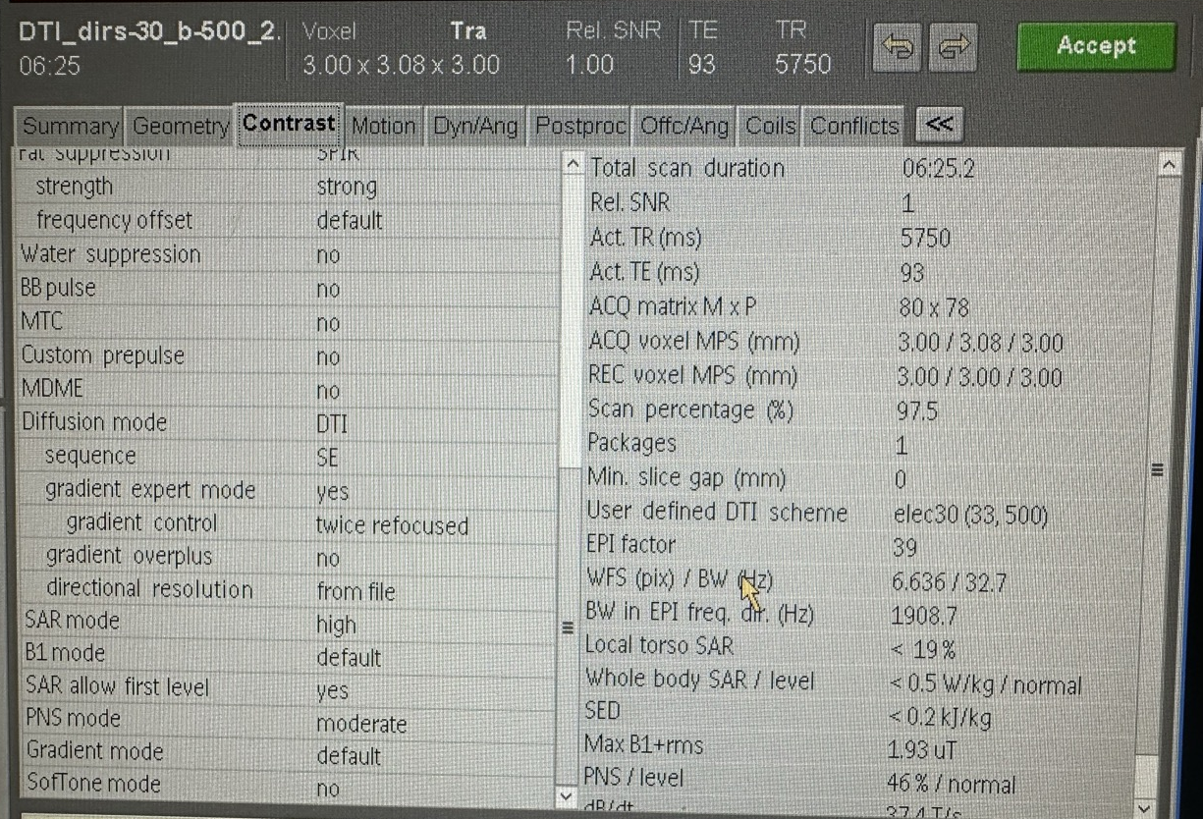
Example Scanner Interface

Slide 33
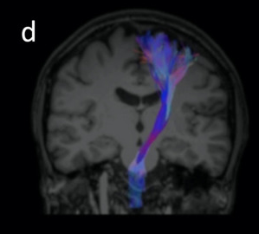
Tractography for Fibre Bundles
Tensors in neighbouring voxels can be used to model the likely trajectory of white matter pathways
Prone to false positives. Incorrect tracts need to be edited
There are a variety of algorithms​
Select a point in a seed region
Follow the likely local direction a small step size
Repeat until termination criterion is reached (eg. low FA)
These steps can be repeated for multiple points in the seed region to generate many streamlines
Christidi et al. 2022. Neurol. Int. 14: 841.
https://pmc.ncbi.nlm.nih.gov/articles/PMC9589952/
Diffusion Basics
Sequences I: Diffusion Encoding
b-value and ADC
Sequences II: Image Encoding
Anisotropy and DTI
Sequences II: Tradeoffs
Sequences II: Artefacts
Processing Pipeline

Slide 34
How do we acquire an image?
Diffusion Basics
Sequences I: Diffusion Encoding
b-value and ADC
Sequences II: Image Encoding
Anisotropy and DTI
Sequences II: Tradeoffs
Sequences II: Artefacts
Processing Pipeline
Notes:
EPI is the reason for diffusion's infamous noisiness.

Slide 35
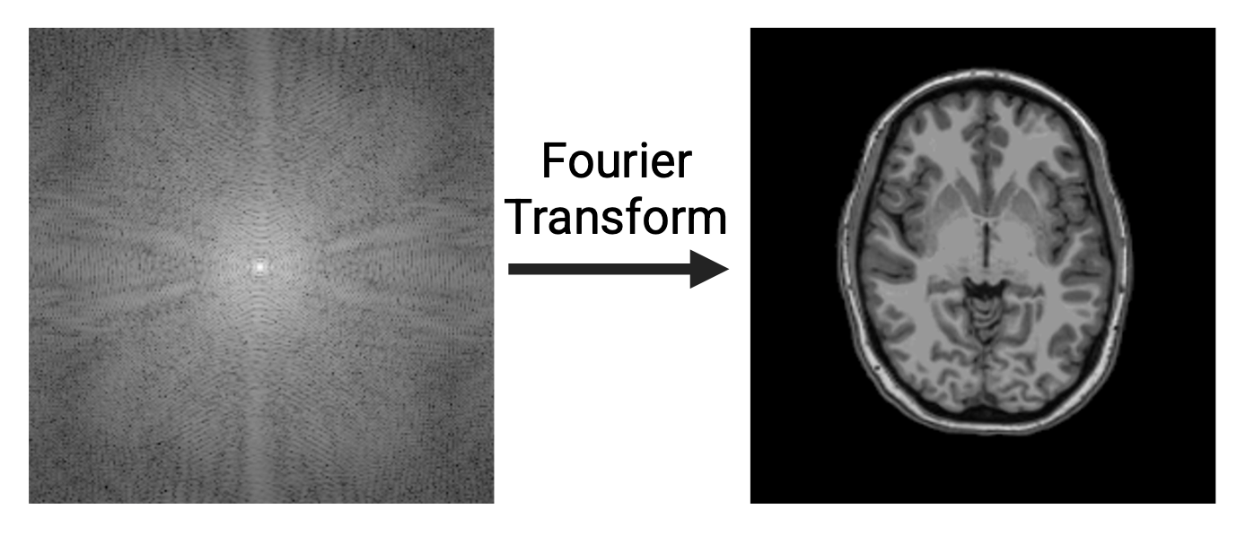
How do we acquire an image?
There are many different ways to traverse k-space
The most common method for clinical diffusion imaging uses echo planar imaging (EPI)
It is fast (for MRI) and less sensitive to motion but prone to certain artefacts
...Image encoding
Diffusion Basics
Sequences I: Diffusion Encoding
b-value and ADC
Sequences II: Image Encoding
Anisotropy and DTI
Sequences II: Tradeoffs
Sequences II: Artefacts
Processing Pipeline
Notes:
EPI is the reason for diffusion's infamous noisiness.

Slide 36
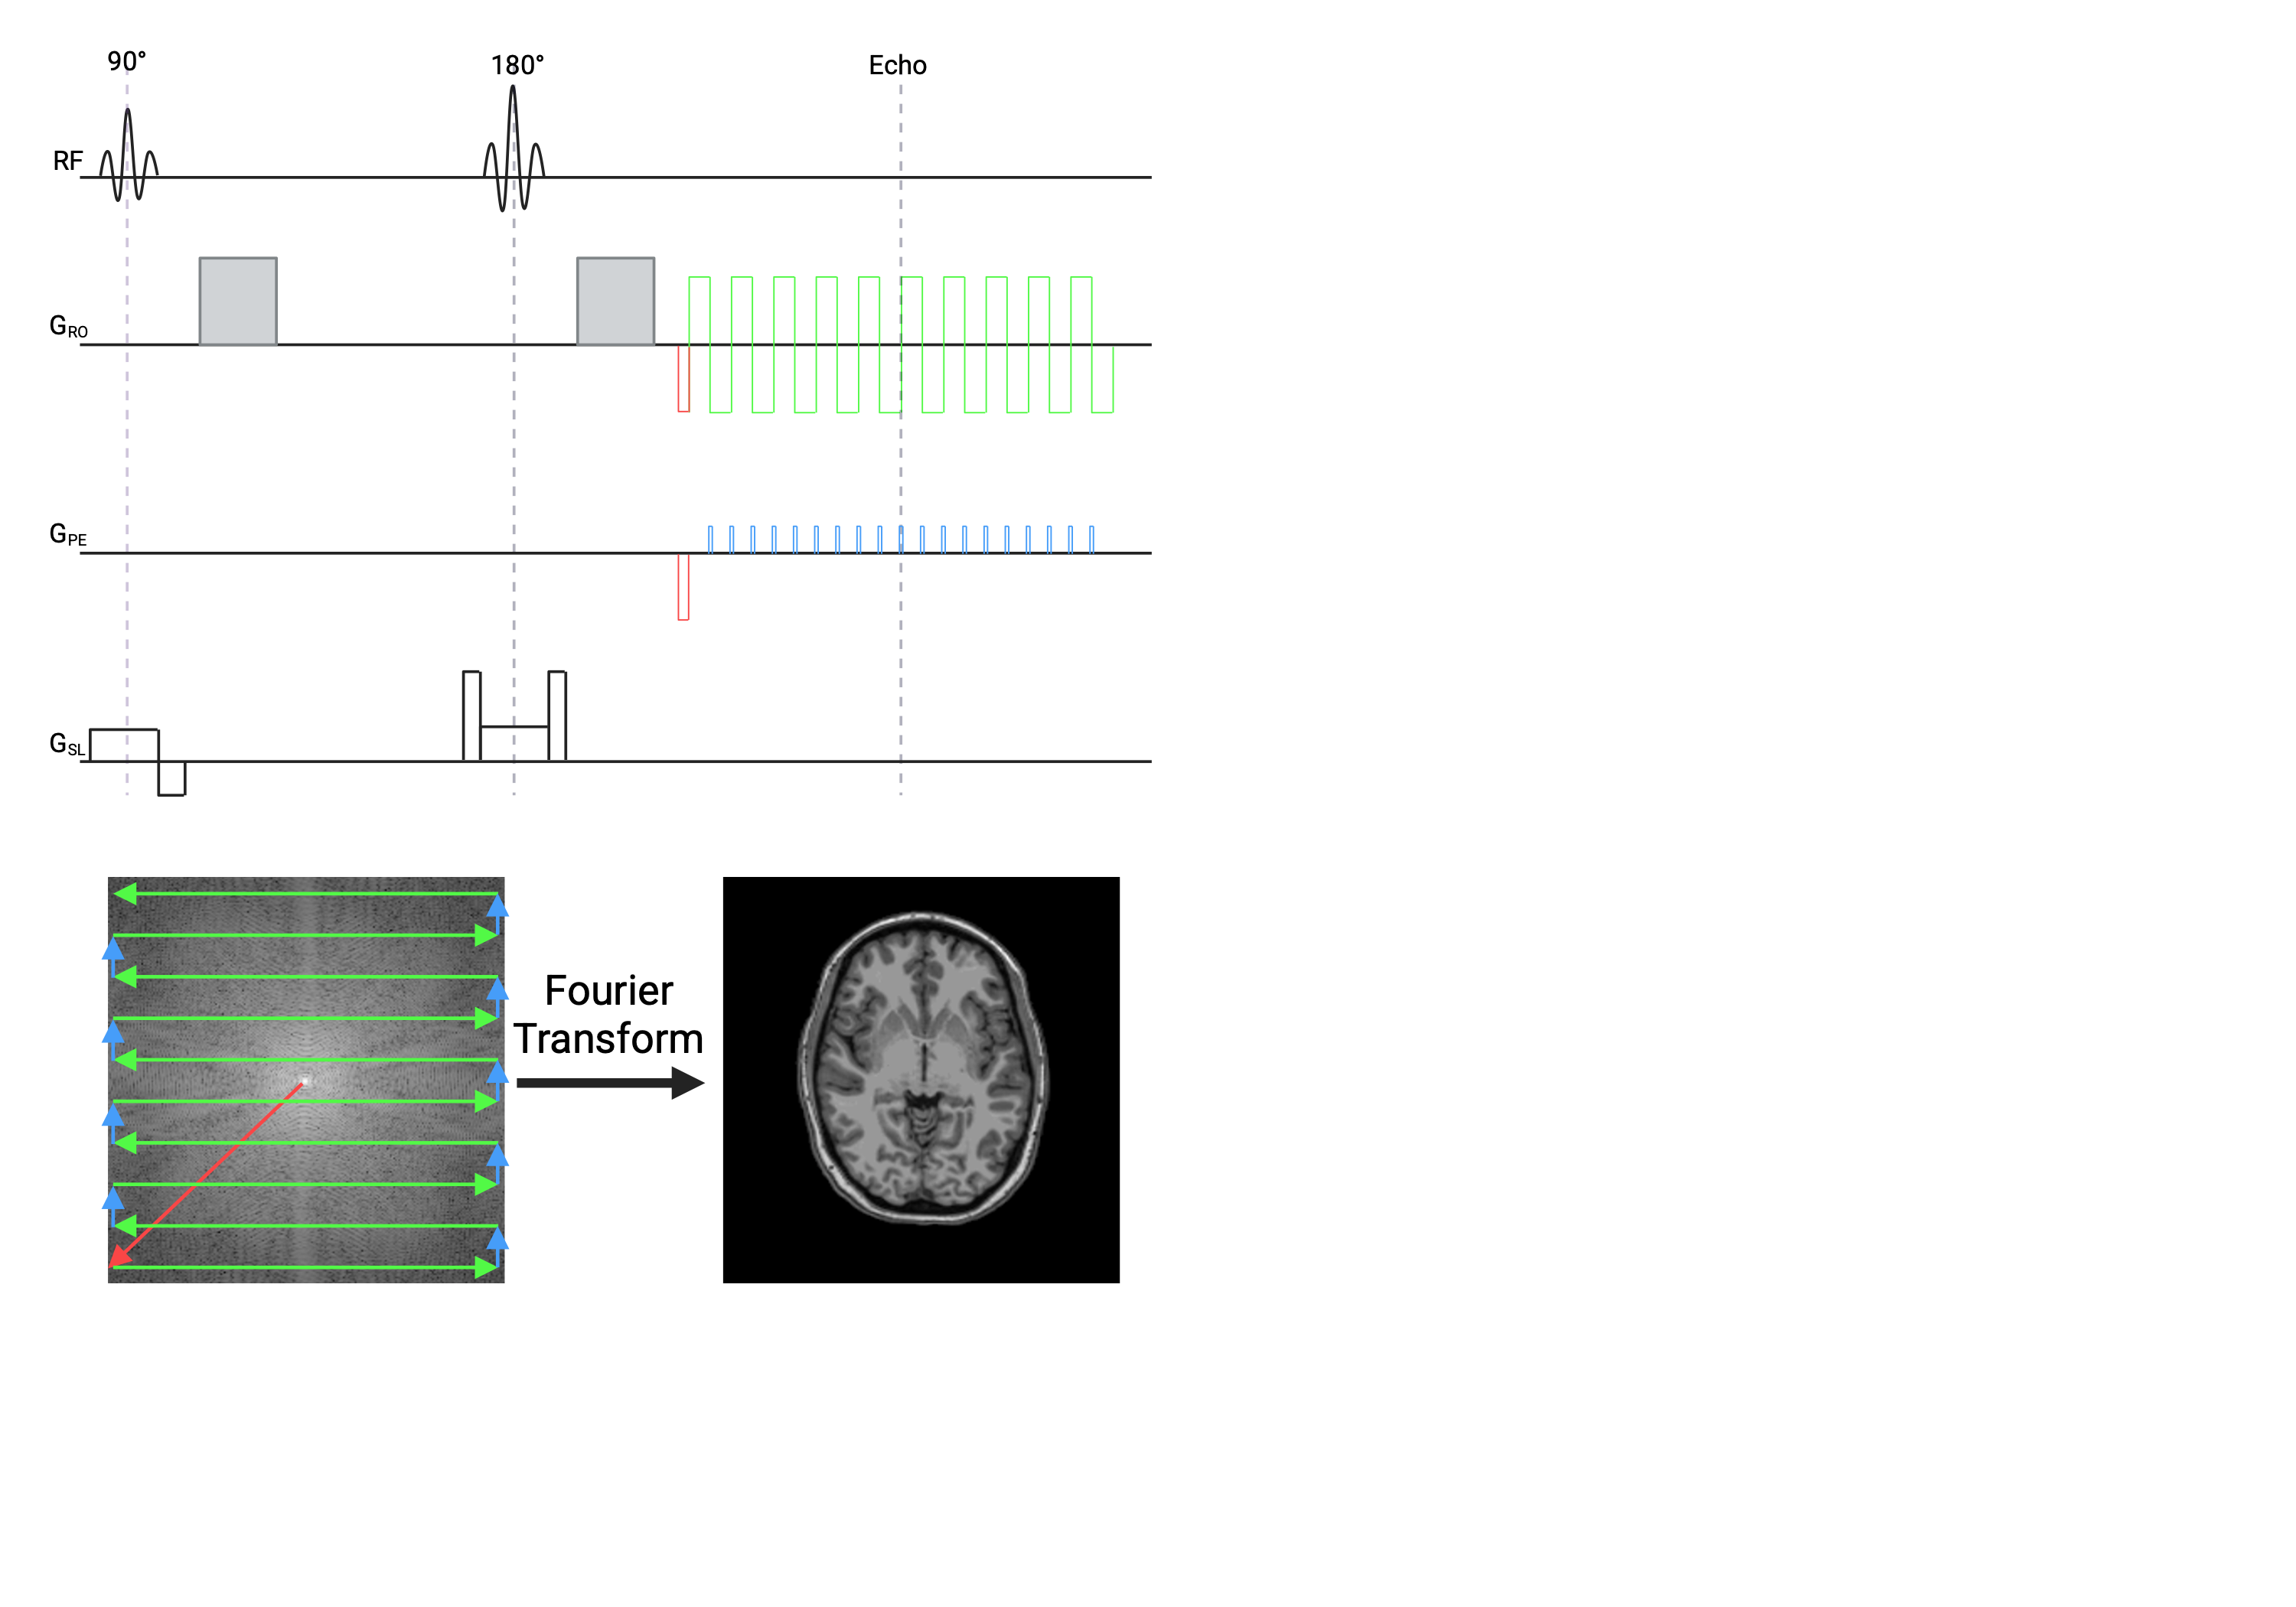
Echo Planar Imaging (EPI)
For a spin echo readout, where every phase encode line is done in a separate TR, the acquisition would take 100x as long!
Time to traverse k-space ~ 50 ms
Interecho time ~ 0.5 ms
N_{PE} ~ 100
Diffusion Basics
Sequences I: Diffusion Encoding
b-value and ADC
Sequences II: Image Encoding
Anisotropy and DTI
Sequences II: Tradeoffs
Sequences II: Artefacts
Processing Pipeline
Notes:
There is an interecho time for the gradient echo spacing in the image encoding, and an echo time defining the peak of the spin echo after the 180 pulse.

Slide 37
Tradeoffs: Diffusion Weighting and Echo Times
TE/2=30 ms
Suppose:
Maximum gradient 40 mT/m
100 phase encodes (20 cm FOV, 2 mm resolution)
TE = 60 ms
What is the maximum b-value?
Δ=30 ms
δ=5 ms
25 ms
b=(γGδ)²(Δ-δ/3)
b=(2.68e⁸*0.04*0.005)²*(0.03-0.005/3)
Time to traverse k-space ~ 50 ms
Interecho time ~ 0.5 ms
N_{PE} ~ 100
b=8.11e⁷ s/m²
b=81 s/mm²
Diffusion Basics
Sequences I: Diffusion Encoding
b-value and ADC
Sequences II: Image Encoding
Anisotropy and DTI
Sequences II: Tradeoffs
Sequences II: Artefacts
Processing Pipeline

Slide 38
Exercise: Help me get more diffusion weighting
TE/2=50 ms
Option 1: Increase TE to 100 ms
Δ=50 ms
b=(γGδ)²(Δ-δ/3)
δ=25 ms
b=2982 s/mm²
Why would we not want to do this?
25 ms
T2 decay and lower SNR
Time to traverse k-space ~ 50 ms
Interecho time ~ 0.5 ms
N_{PE} ~ 100
Diffusion Basics
Sequences I: Diffusion Encoding
b-value and ADC
Sequences II: Image Encoding
Anisotropy and DTI
Sequences II: Tradeoffs
Sequences II: Artefacts
Processing Pipeline

Slide 39
Exercise: Help me get more diffusion weighting
TE/2=30 ms
Option 2: Lower resolution 4 mm
Δ=30 ms
b=(γGδ)²(Δ-δ/3)
b=847 s/mm²
δ=17.5 ms
What are the advantages and disadvantages of this?
12.5 ms
Lower spatial resolution
4x as much SNR
Would need to scan 16x a long for equivalent SNR gain
Time to traverse k-space ~ 25 ms
Interecho time ~ 0.5 ms
N_{PE} ~ 50
Diffusion Basics
Sequences I: Diffusion Encoding
b-value and ADC
Sequences II: Image Encoding
Anisotropy and DTI
Sequences II: Tradeoffs
Sequences II: Artefacts
Processing Pipeline

Slide 40
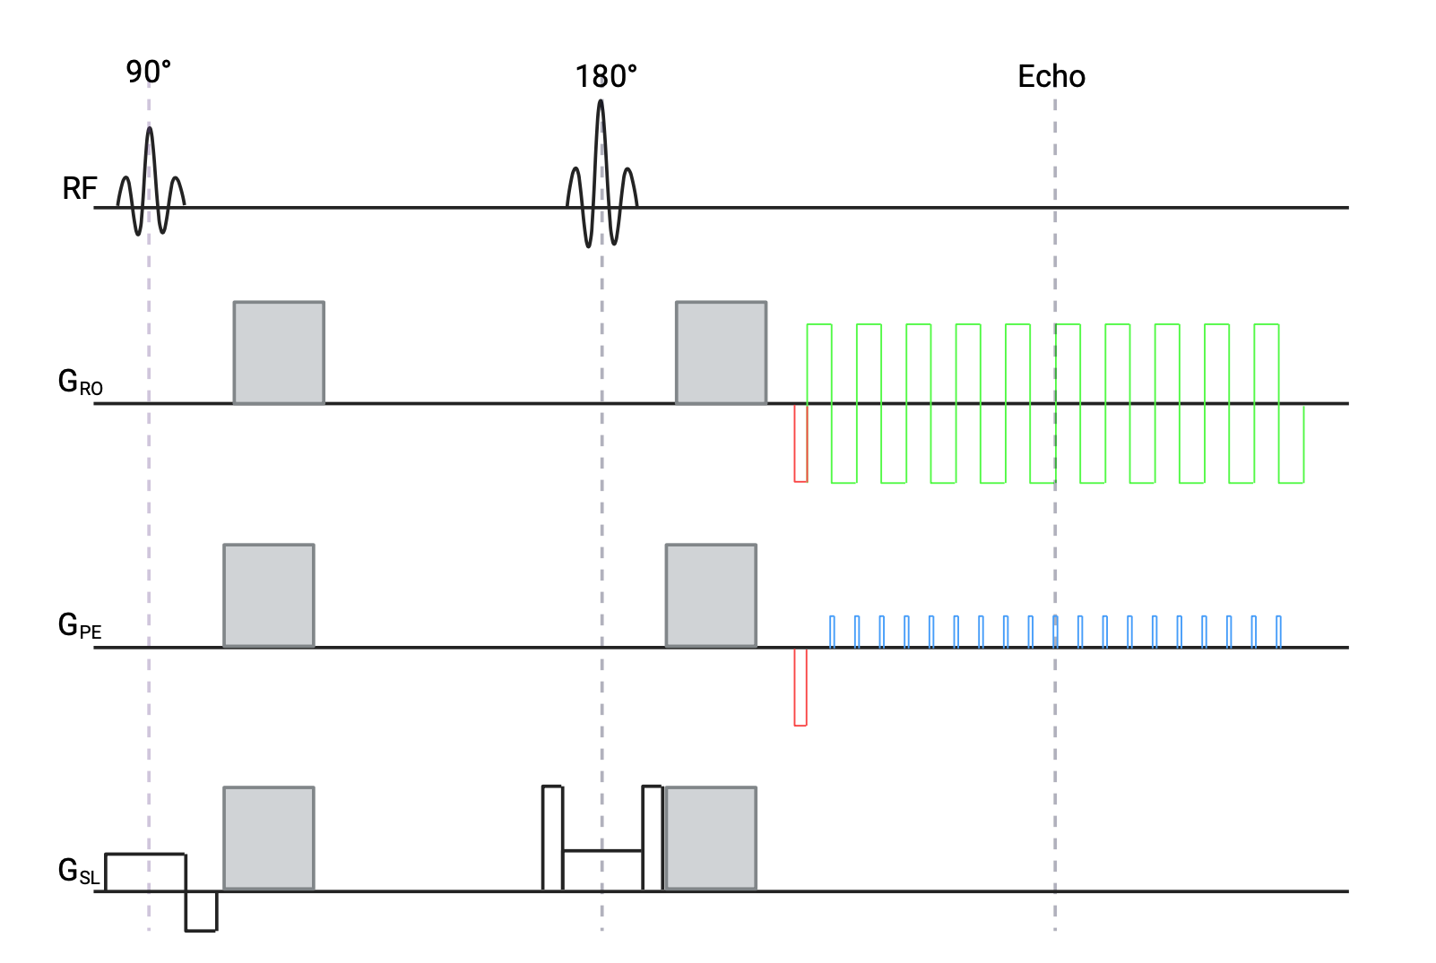
Exercise: Help me get more diffusion weighting
TE/2=30 ms
Option 3: Turn on all 3 gradients
G_{all}=sqrt(3)*0.04
Δ=30 ms
b=(γGδ)²(Δ-δ/3)
δ=5 ms
b=243 s/mm²
Why would we not want to do this?
25 ms
This only works in 4 directions
Time to traverse k-space ~ 50 ms
Interecho time ~ 0.5 ms
N_{PE} ~ 100
Diffusion Basics
Sequences I: Diffusion Encoding
b-value and ADC
Sequences II: Image Encoding
Anisotropy and DTI
Sequences II: Tradeoffs
Sequences II: Artefacts
Processing Pipeline

Slide 41
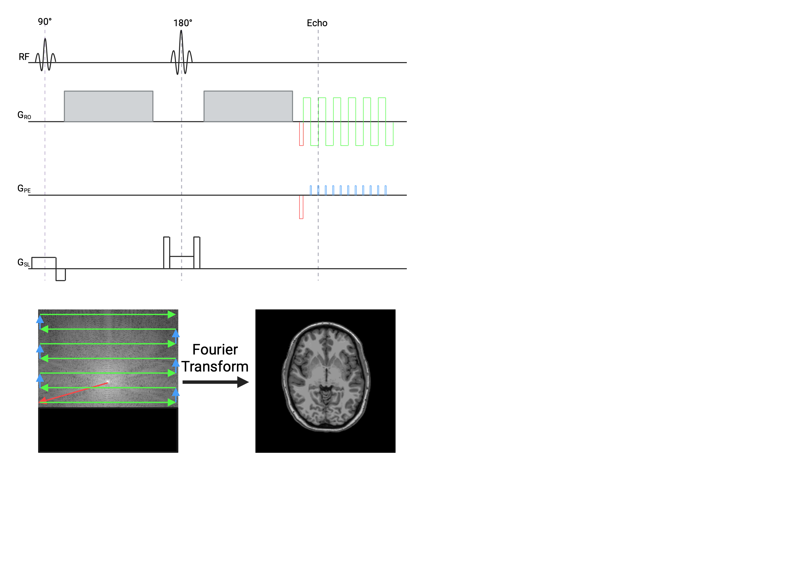
Exercise: Help me get more diffusion weighting
TE/2=30 ms
Option 4: Partial Fourier Encoding of 0.6
Δ=30 ms
b=(γGδ)²(Δ-δ/3)
δ=25 ms
5 ms
b=1550 s/mm²
Parallel imaging is another option to reduce the number of phase encodes:
Multiple receive coils
SENSE or GRAPPA
Time to traverse k-space ~ 30 ms
Interecho time ~ 0.5 ms
N_{PE} ~ 60
Diffusion Basics
Sequences I: Diffusion Encoding
b-value and ADC
Sequences II: Image Encoding
Anisotropy and DTI
Sequences II: Tradeoffs
Sequences II: Artefacts
Processing Pipeline
Notes:
Is it worth having another slide for parallel imaging just to show that you're covering all of k-space, but only every other line (but with two coils and then you reconstruct)

Slide 42
Exercise: Help me get more diffusion weighting
TE/2=30 ms
Template
Δ=30 ms
b=(γGδ)²(Δ-δ/3)
δ=5 ms
b=2982 s/mm²
Why would we not want to do this?
25 ms
T2 decay and lower SNR
Time to traverse k-space ~ 50 ms
Interecho time ~ 0.5 ms
N_{PE} ~ 100

Slide 43
A note about slices
Examples above are for one slice
EPI data is often acquired "multi-slice" not "3D"
Slice selection + 2D k-space
Repeat the slice-selective excitation for different slices during TR
More slices require longer TR, so there is some increase in imaging time
It is possible to acquire 3D k-space and do a 3D Fourier transform
Requires long echo times unless there are few phase encodes
Has advantages for resolution
Diffusion Basics
Sequences I: Diffusion Encoding
b-value and ADC
Sequences II: Image Encoding
Anisotropy and DTI
Sequences II: Tradeoffs
Sequences II: Artefacts
Processing Pipeline

Slide 44

EPI Artefacts: Susceptibility-based distortion
TSE
Off-resonance distribution at 3T
Images: Fa-Hsuan Lin
EPI
Diffusion Basics
Sequences I: Diffusion Encoding
b-value and ADC
Sequences II: Image Encoding
Anisotropy and DTI
Sequences II: Tradeoffs
Sequences II: Artefacts
Processing Pipeline

Slide 45
EPI Artefacts: Susceptibility-based distortion
The bandwidth per pixel in the readout direction is: 1/0.0005 = 2000 Hz/px
In the phase direction, bandwidth per pixel is: 1/0.05 = 20 Hz/px
Susceptibility that varies the B0 field by 100 Hz creates a shift:
100/2000 = 0.05 pixels in readout
100/20 = 5 pixels in phase
Appears as stretch or compression in phase encode direction
T_{phase}~50 ms
T_{read}~0.5 ms
Diffusion Basics
Sequences I: Diffusion Encoding
b-value and ADC
Sequences II: Image Encoding
Anisotropy and DTI
Sequences II: Tradeoffs
Sequences II: Artefacts
Processing Pipeline

Slide 46
EPI Artefacts: Susceptibility-based distortion
Fixes
Reduce susceptibility
Shimming
Thinner slices
Correct for susceptibility
Acquire a B0 map and correct in post-processing or use to shim
Acquire an image with "reverse blip"
Reduce # phase encodes
Partial Fourier
Parallel imaging
Choose the "right" phase encode direction
T_{phase}~50 ms
T_{read}~0.5 ms
Diffusion Basics
Sequences I: Diffusion Encoding
b-value and ADC
Sequences II: Image Encoding
Anisotropy and DTI
Sequences II: Tradeoffs
Sequences II: Artefacts
Processing Pipeline

Slide 47
Chemical Shift Artefact
Fat is shifted 3.5 ppm from water, about 450 Hz at 3 T
For readout bandwidth of 2000 Hz/px, this is 0.2 pixels
For phase bandwidth of 20 Hz/px, this is 22 pixels
Fat signal attenuates less than water, so artefact may be more obvious in DWI than unweighted image.
Use scanner fat saturation
Chemical shift
Diffusion Basics
Sequences I: Diffusion Encoding
b-value and ADC
Sequences II: Image Encoding
Anisotropy and DTI
Sequences II: Tradeoffs
Sequences II: Artefacts
Processing Pipeline

Slide 48

Eddy current distortions
Turning on and off gradients induces eddy currents, changes effective gradient
Two problems:
Diffusion gradients aren't what we plan (altered b-value)
EPI readout will not be as expected, creating artefacts
This effect will be worse for stronger diffusion gradients
Diffusion Basics
Sequences I: Diffusion Encoding
b-value and ADC
Sequences II: Image Encoding
Anisotropy and DTI
Sequences II: Tradeoffs
Sequences II: Artefacts
Processing Pipeline

Slide 49
Eddy Current Distortions - Readout
Shear
Diffusion Basics
Sequences I: Diffusion Encoding
b-value and ADC
Sequences II: Image Encoding
Anisotropy and DTI
Sequences II: Tradeoffs
Sequences II: Artefacts
Processing Pipeline

Slide 50

Eddy Current Distortions - Phase
Stretch
Diffusion Basics
Sequences I: Diffusion Encoding
b-value and ADC
Sequences II: Image Encoding
Anisotropy and DTI
Sequences II: Tradeoffs
Sequences II: Artefacts
Processing Pipeline

Slide 51

Eddy Current Distortions - Slice
These are all approximately affine transformations.
Can be corrected through affine registration.
Translation
Diffusion Basics
Sequences I: Diffusion Encoding
b-value and ADC
Sequences II: Image Encoding
Anisotropy and DTI
Sequences II: Tradeoffs
Sequences II: Artefacts
Processing Pipeline

Slide 52

EPI ghosts
k-space acquisition alternates direction for even and odd lines
Small timing differences produce phase differences
These appear as ghosts in image space
Always in the phase direction, a distance of N/2 apart
Many scanners have automatic correction based on pre-scan or navigators
Diffusion Basics
Sequences I: Diffusion Encoding
b-value and ADC
Sequences II: Image Encoding
Anisotropy and DTI
Sequences II: Tradeoffs
Sequences II: Artefacts
Processing Pipeline

Slide 53

Potential Eddy Current Solutions
Worse at high gradients
Use a "self-compensating" sequence like TRSE
Longer TE for a given b-value
Correction acquired during pre-scan
Distortions can often be fixed with affine registration
Can be challenging as contrast changes
Diffusion Basics
Sequences I: Diffusion Encoding
b-value and ADC
Sequences II: Image Encoding
Anisotropy and DTI
Sequences II: Tradeoffs
Sequences II: Artefacts
Processing Pipeline

Slide 54


Multi-Shot Imaging and Motion
EPI phase encodes can be split into separate TRs (multi-shot EPI)
Shots may be seconds apart vs 50 ms for single shot
Motion between shots causes phase errors
Brain pulsations from heart
Cardiac gating adds scan time
Acquire a navigator for phase correction
Diffusion Basics
Sequences I: Diffusion Encoding
b-value and ADC
Sequences II: Image Encoding
Anisotropy and DTI
Sequences II: Tradeoffs
Sequences II: Artefacts
Processing Pipeline

Slide 55
Multi-Shot Imaging and Motion
Multi-shot EPI with interleaved phases may have gaps in k-space after correction
Could leave residual ghosting
Readout-segmented EPI is an alternative (eg. RESOLVE)
Overlap segments so there are no gaps after correction
Diffusion Basics
Sequences I: Diffusion Encoding
b-value and ADC
Sequences II: Image Encoding
Anisotropy and DTI
Sequences II: Tradeoffs
Sequences II: Artefacts
Processing Pipeline

Slide 56
Image Processing Steps and Analysis Tools
Look at the data (SNR, artefacts)
Susceptibility correction with B0 map or reverse blip
Motion correction
b-vector correction
Eddy current correction
Segment brain
Apply model (eg. DTI)
Calculate metrics (MD, FA)
Compare subjects
Many scanners automatically do eddy current correction, calculate ADC and FA
Software often has its own tutorial
FSL (Oxford)
DTIStudio (Johns Hopkins)
Camino (UCL)
3DSlicer with SlicerDMRI extension (NIH), Tutorial.
Diffusion Basics
Sequences I: Diffusion Encoding
b-value and ADC
Sequences II: Image Encoding
Anisotropy and DTI
Sequences II: Tradeoffs
Sequences II: Artefacts
Processing Pipeline

